Slide 1
1837 Rebellions; causes and effects
IB History: Year 1
Nation-Building

Slide 2
Constitutional Act of 1791
Established to help the 10,000 English speaking people adjust in Canada after the American Revolution.
Reformed the government of Canada
Split it into two
Upper Canada
Family Compact- group that held most of the power
Lower Canada
Chateau Clique

Slide 3
Upper Canada

Slide 4
Lower Canada

Slide 5
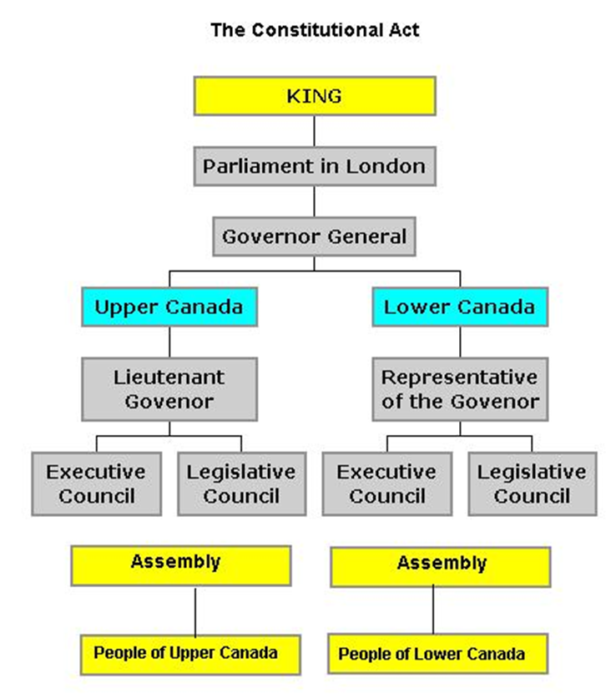

Slide 6
Background
Following a theme of revolutions
American Revolution of 1776
French Revolution of 1789-1799
Haitian Revolution 1791-1794
Irish Rebellion of 1798
Sought republicanism
As it was being implemented around the world
Believed it was the right of the citizens to be apart of the political process.

Slide 7
Two Poles by 1834
Two poles
Supporters of the “Chateau Clique”
Reformers the Parti Patriote led by Louis-Joseph Papineau & William Lyon MacKenzie’s Reform Party

Slide 8
Two Poles by 1834
Legislative Assembly
Wanted people to have power
Liberalism & Republicanism
Supporters of Family Compact & Chateau Clique
General Governor; Colonial Authorities
Supposed to be one capable, experienced, qualified leader.
Reality- Usually family friend, relative, or business venture.
Conservative & Toryism
Tory’s were loyal to the British cause and government.
Notes:
Republicanism- Supreme power is held by elected representatives (not king)
Liberalism- favored individual rights, free trade, political and social reform.
Conservative- supported free enterprise and private ownership.
Toryism- favored the established church (Anglican), political empirial order, and loyalty to the Crown.

Slide 9
Causes
Responsible government
conception of a system of government that embodies the principle of parliamentary accountability, the foundation of the Westminster system of parliamentary democracy
Similar to a social contract
The government (parliament) answers to the people; not the monarch

Slide 10
Causes
Hard economic times
Wheat produced poor yields in 1836
Meant farmers did not have enough to pay off debts and buy supplies for the next year.
Poor farming practices
Failure to rotate crops
Lack of manufacturing jobs
Farmers did not have extra money so they couldn’t buy manufactured goods which meant manufacturing struggled.
Pre-industrial; Agriculturally based economies

Slide 11
Causes
Immigration
Clusters of cities
Led to over-crowding in cities and lack of facilities
Poverty
Epidemics due to poor sanitation
Inequality of land
Huge tracts of land were in the hands of British elite
Hope was the elite would sell bits to help settle Canada
Absentee owners; did little to develop land
Put more wealth into the hands of the elite

Slide 12
Causes
Political developments
Government in Canada was made through appoints.
Starting with the British Crown and moving down to the Governor General in Lower Canada and the Lieutenant Governor in Upper Canada.
Legislative Assembly was elected by the people (male electorate)
Very limited powers
Deliberate because of 13 colonies revolt

Slide 13
Causes
Social inequality
Hierarchical society
Power in the hands of the elite
British officials, business people and landowners.
Asked to be protected from influences and disorder that caused the American Revolution (1827)
Argued hierarchical society promoted security for growth
Working class and middle class had little control over the economy and society in Lower Canada.
Even when 90% of the Assembly was made up of Parti Canadiens (opposed to British Tory rule)

Slide 14
Causes Upper Canada
Clergy reserves
One-seventh of land went to the Church of England
Slowed process of settlement and put more wealth into the hands of the established church and elites
Protests were not as clearly defined as in Lower Canada

Slide 15
Causes Lower Canada
More ethnically based (Quebec was mostly French)
English and Irish immigrants made the French feel they would lose their language, religion and culture, in short – assimilation.
House of Assembly
90% of elected seats were controlled by Parti Canadiens (those opposed to Tory rule and later became Parti Patriote)
French still had little control over economy and society

Slide 16
Causes Lower Canada
1836 tensions rise
Evidence of the gridlock between the appointed and elected in the legislature of Lower Canada.
Schools, city councils, public offices shut down
Elected refused to vote more funds
British government provides permission to spend without Assembly’s approval.
Became illegal for people to gather and criticize gov.
Political meetings become military training camps
British government responds by sending troops to Lower Canada

Slide 17
Effects Upper Canada
Imprisonment
Government suspended

Slide 18
Effects Lower Canada
Much harsher
Imprisonment
Government abolished.
Villages/fields burnt
Dispossession
Removed from their land

Slide 19
Immediate Effects
Lord Durham sent to investigate the rebellions
Writes the Durham Report (1839)
Later becomes governor of both Canadas.
Tories make reforms
Special Council created in Lower Canada
Union of Canadas in 1840
Long Term
Gradual autonomy from Great Britain
1931
1982
Notes:
The Special Council of Lower Canada was an appointed body which administered Lower Canada until the Union Act of 1840 created the Province of Canada. Following the Lower Canada Rebellion, on March 27, 1838, the Constitutional Act of 1791 was suspended and both the Legislative Assembly and Legislative Council were dissolved.

Slide 20
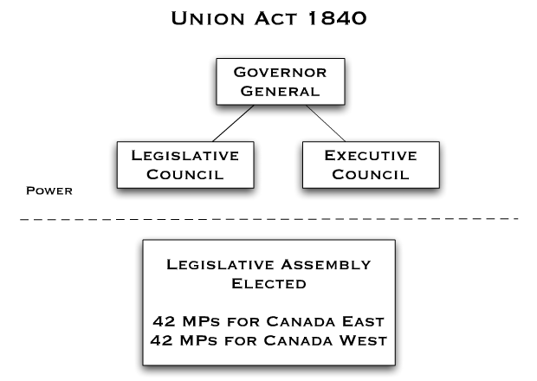

Slide 21
The Durham Report

Slide 22
What is the Durham Report?
Lord Durham was sent to the Canada in 1838 to investigate the causes of the rebellions
Referred to French as people with “no history and no literature”
"two nations warring in the bosom of a single state.“
War based on race, not principles
Notes:
Lord Durham was sent to the Canada in 1838 to investigate the causes of the rebellions and to find solutions to the political problems plaguing Upper and Lower Canada.
In February 1839, in a report made to the British parliament, Lord Durham infuriated the French when he referred to them as inferior to the English and "as a people with no history and no literature".
In the report he explained that he expected to find a conflict between a government and a people, but instead found two nations at war within the same state.
It was a war based on race, not on principles. In his opinion, Canada was a land of two hostile groups: the French and the English.

Slide 23
Durham’s solution
Unite Upper and Lower Canada
Assimilate the French
Grant Responsible Government
Upper and Lower Canada were united in 1840
Responsible government was granted in 1848
Notes:
to unite Upper and Lower Canada to make the French a minority
to assimilate or anglicize the French majority in Lower Canada
to grant responsible government
Responsible government
conception of a system of government that embodies the principle of parliamentary accountability, the foundation of the Westminster system of parliamentary democracy
Similar to a social contract
The government (parliament) answers to the people; not the monarch
To assimilate: the to the same
Anglicize: to make English

Slide 24
Act of Union in 1840
The act United Upper Canada and Lower Canada into the Province of Canada.
It gave the united colony one legislative assembly
combined the debts of the two colonies despite the fact that Lower Canada's debts were less.
made English the only official language in the assembly.
Notes:
one legislative assembly with 42 elected members from Canada West, formerly Upper Canada, (population 400,000) and 42 elected members from Canada East, formerly Lower Canada, (population 600,000).
rejected Lord Durham's proposal for responsible government; however, an alliance between Robert Baldwin, leader of the reformers in Canada West and Louis-Hippolyte Lafontaine, leader of the moderate reformers in Canada East, brought in responsible government by 1848.

Slide 25
Responsible Government
Responsible government requires that government ministers should be elected members of the legislative assembly, not appointed by the governor
If the government cannot keep a majority it must resign. It is the basic principle upon which Canada's parliament and provincial governments is based.
The government is directly responsible to the elected members of parliament or the legislature.

Slide 26
Responsible Government Achieved
In the 1848 election, the Reformers led by Baldwin and Lafontaine won a large majority of the seats in the legislative assembly.
Lord Elgin, the new Governor of Canada, asked them to form the government.
Notes:
Baldwin and Lafontaine appoint an executive council or cabinet from members of their own party and this council, with the approval of the assembly, was to make government policy.
In 1849, the Rebellion Losses Bill, which would compensate persons who had suffered property damage in Lower Canada during the rebellion, was approved by the executive council (cabinet) and passed by the legislative assembly.
Lord Elgin, although personally against the bill, signed it on the grounds that under responsible government he was bound to follow the advice of the executive council.

Slide 27
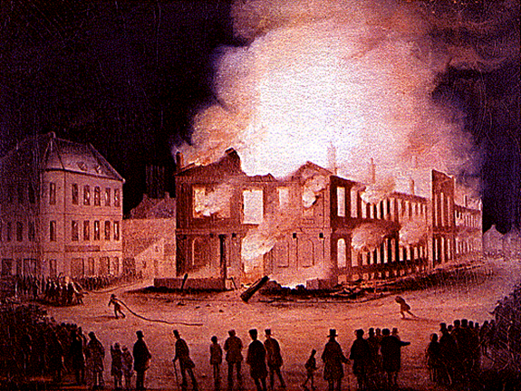
Burning of the Parliament Building
Notes:
Elgin was physically assaulted by an English-speaking mob for this (assenting to the Rebellion Losses Bill of 1849), and the Montreal Parliament building was burned to the ground in the ensuing riots. Nonetheless, the Rebellion Losses Bill helped entrench responsible government into Canadian politics.

Slide 28
More Impacts
Canada gradually gained greater and greater autonomy over a considerable period of time through inter imperial and commonwealth diplomacy
British North America Act of 1867
Notes:
British North America Act, also called Constitution Act, 1867, the act of Parliament of the United Kingdom by which in 1867 three British colonies in North America—Nova Scotia, New Brunswick, and Canada—were united as “one Dominion under the name of Canada” and by which provision was made that the other colonies and territories of British North America might be admitted. It also divided the province of Canada into the provinces of Quebec and Ontario and provided them with constitutions. The act served as Canada’s “constitution” until 1982, when it was renamed the Constitution Act, 1867, and became the basis of Canada’s Constitution Act of 1982, by which the British Parliament’s authority was transferred to the independent Canadian Parliament.
Canada dates its history as a country to the British North America Act, 1867, which came into effect on July 1, 1867. However, Canada was not established as fully independent, since the United Kingdom retained legislative control over Canada and full control over Canadian foreign policy.
The Act, also known as the BNA Act, comprises a major part of the Constitution of Canada. The Act entails the original creation of a federal dominion and sets the framework for much of the operation of the Government of Canada, including its Federal structure, the House of Commons, the Senate, the justice system, and the taxation system.

Slide 29
Challenges to Confederation

Slide 30
Challenges to Confederation
Authorities of London indifferent to the idea
Nova Scotia, New Brunswick, Prince Edward Island, and Newfoundland, were also discussing a political union with each other.
Regionalism
Conferences
Charlottetown, 1864
Quebec, 1864 (Conflict over Provincial v. Unitary rights)
London, 1866 (Major conflict was education system)
Notes:
Charlottetown
The conference was originally planned as a meeting of representatives from the Maritime colonies: Nova Scotia, New Brunswick and Prince Edward Island. Newfoundland agreed with the movement, but was not notified in time to take part in the proceedings.^{[1]} Britain encouraged a Maritime Union between these colonies, hoping that they would then become less economically and politically dependent on the Crown, and provide for greater economic and military power for the region in light of the American Civil War. However, another colony, the Province of Canada, comprising present-day Ontario and Quebec, heard news of the planned conference and asked that the agenda be expanded to discuss a union that would also include them.
Most of the Maritimes were convinced that a wider union including the Province of Canada would also be beneficial to them; Prince Edward Island was unsure, however, and very much against confederation. The delegates also believed that union could be achieved within a few years, rather than in an undefined period in the future as they had originally planned.
Quebec
The conference began on October 10. The major source of conflict at the conference was between those who favoured a "legislative union", i.e. a unitary state, such as John A. Macdonald, and those who favoured stronger provincial rights. Representatives from the Maritimes and Canada East (now Quebec) tended to argue for provincial rights, fearing they would lose their cultural identity under a centralized unitary state. Macdonald thought the failure of a weak central power was evident in the American Civil War, which was still being fought in the United States as the delegates met in Charlottetown and Quebec. The delegates eventually compromised, dividing powers between a "general" parliament and "local" provincial legislatures. They also decided to have an elected lower house, the House of Commons, and an appointed upper house, the Senate, although there was considerable debate about how many senators each province would have. The Prince Edward Island delegation called for a scheme similar to the Triple-E Senate proposal of the 1990s. Eventually, a proposed structure for the government was written out in the form of the seventy-two resolutions at the end of the conference.
London
Sixteen delegates from the Province of Canada, Nova Scotia, and New Brunswick gathered with officials of the British government to draft the British North America Act, 1867. This was a continuation of the Quebec Conference held earlier about the "Seventy-two Resolutions". A major issue of contention was the education system, withRoman Catholic bishops lobbying for guarantees protecting the separate school system, This was opposed by delegates from the Maritimes, and the compromise reached was Section 93 of the act, which guaranteed separate school systems in Quebec and Ontario but not in Nova Scotia or New Brunswick. The result of this meeting was the British North America Act. This was the last of the conferences discussing Confederation.

Slide 31
British North America Act of 1867

Slide 32
BNA Act of 1867
Also called Constitution Act, 1867
Act of Parliament of the United Kingdom
Three British colonies in North America—Nova Scotia, New Brunswick, and Canada—were united as “one Dominion under the name of Canada”
Other colonies and territories of British North America could be admitted.
Divided the province of Canada into the provinces of Quebec and Ontario and provided them with constitutions.
Autonomy extended only to internal affairs. External affairs, such as border negotiations with the United States, were still controlled from Britain

Slide 33
Compromises
“Dominion” rather than “Kingdom of Canada”
Conferences
Charlottetown, 1864
Quebec, 1864 (Conflict over Provincial v. Unitary rights)
compromised dividing powers between a "general" parliament and "local" provincial legislatures
London, 1866 (Major conflict was education system)
compromise reached guaranteed separate school systems in Quebec and Ontario but not in Nova Scotia
Notes:
John A. Macdonald had spoken of "founding a great British monarchy" and wanted the newly created country to be called the "Kingdom of Canada."^{[63]} Although it had its monarch in London, the Colonial Office opposed as "premature" and "pretentious" the term "kingdom", as it was felt it might antagonize the United States. The term dominion was chosen to indicate Canada's status as a self-governing polity of the British Empire, the first time it was used in reference to a country.
Charlottetown
The conference was originally planned as a meeting of representatives from the Maritime colonies: Nova Scotia, New Brunswick and Prince Edward Island. Newfoundland agreed with the movement, but was not notified in time to take part in the proceedings.^{[1]} Britain encouraged a Maritime Union between these colonies, hoping that they would then become less economically and politically dependent on the Crown, and provide for greater economic and military power for the region in light of the American Civil War. However, another colony, the Province of Canada, comprising present-day Ontario and Quebec, heard news of the planned conference and asked that the agenda be expanded to discuss a union that would also include them.
Most of the Maritimes were convinced that a wider union including the Province of Canada would also be beneficial to them; Prince Edward Island was unsure, however, and very much against confederation. The delegates also believed that union could be achieved within a few years, rather than in an undefined period in the future as they had originally planned.
Quebec
The conference began on October 10. The major source of conflict at the conference was between those who favoured a "legislative union", i.e. a unitary state, such as John A. Macdonald, and those who favoured stronger provincial rights. Representatives from the Maritimes and Canada East (now Quebec) tended to argue for provincial rights, fearing they would lose their cultural identity under a centralized unitary state. Macdonald thought the failure of a weak central power was evident in the American Civil War, which was still being fought in the United States as the delegates met in Charlottetown and Quebec. The delegates eventually compromised, dividing powers between a "general" parliament and "local" provincial legislatures. They also decided to have an elected lower house, the House of Commons, and an appointed upper house, the Senate, although there was considerable debate about how many senators each province would have. The Prince Edward Island delegation called for a scheme similar to the Triple-E Senate proposal of the 1990s. Eventually, a proposed structure for the government was written out in the form of the seventy-two resolutions at the end of the conference.
London
Sixteen delegates from the Province of Canada, Nova Scotia, and New Brunswick gathered with officials of the British government to draft the British North America Act, 1867. This was a continuation of the Quebec Conference held earlier about the "Seventy-two Resolutions". A major issue of contention was the education system, withRoman Catholic bishops lobbying for guarantees protecting the separate school system, This was opposed by delegates from the Maritimes, and the compromise reached was Section 93 of the act, which guaranteed separate school systems in Quebec and Ontario but not in Nova Scotia or New Brunswick. The result of this meeting was the British North America Act. This was the last of the conferences discussing Confederation.

Slide 34
Unresolved Issues
Provinces that did not want to be included (e.g. Nova Scotia)
No explicit bill of rights
Lack of full autonomy
Provincial v. Dominion dominated power
Ontario pushed for provincial rights
Led by Oliver Mowat
Led to a series of court decisions
Conflict involving disputed land between Ontario and Manitoba.
Mowat sends troops to area as did Manitoba
Notes:
The Anti-Confederation Party won 18 out of 19 federal Nova Scotia seats in September 1867, and in the Nova Scotia provincial election of 1868, 36 out of 38 seats in the legislature. For seven years, William Annand and Joseph Howe led the ultimately unsuccessful fight to convince British imperial authorities to release Nova Scotia from Confederation. The government was vocally against Confederation, contending that it was no more than the annexation of the province to the pre-existing province of Canada.

Slide 35
Regionalism
Concern for the development of one's own area over the development of the whole country.
Canada’s regions are very different from each other.
Differences in geography, language, culture, and economy.
Notes:
Quebec has held two referendums to remove itself from the Confederation, nearly succeeding the second time.

Slide 36
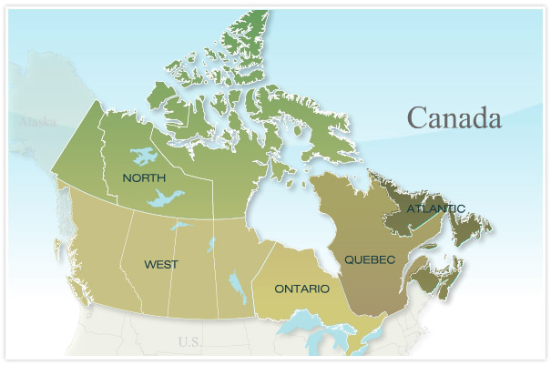
5 Regions

Slide 37
Effects
Began the process that was to culminate complete autonomy from Britain
Westminster Statute, 1931- Legislative equality
Constitution Act, 1982- Completed independence
Expansionism
Canadian Pacific Railway (Finished 1884)
North-West Rebellion
Metis rose up to fight expansionism and Mounties 1885
Eventual Confederation of Canadian Provinces
British Columbia, 1871
Prince Edward Island, 1873
Newfoundland and Labrador, 1949
Notes:
The Statute of Westminster 1931 is an Act of the Parliament of the United Kingdom and identical but separate versions of it are now domestic law within each of the other Commonwealth realms, to the extent that they have not been implicitly repealed by subsequent laws. Passed on 11 December 1931, the act established legislative equality between the self-governing Dominions of the British Empireand the United Kingdom, thereby marking the effective legislative independence of these countries, either immediately or upon ratification. The Statute of Westminster's relevance today is that it sets the basis for the continuing relationship between theCommonwealth realms and the Crown.^{[2]}
The Canada Act 1982 (1982 c. 11) is an Act of the Parliament of the United Kingdom that was passed at the request of the Canadian federal government to "patriate" Canada's constitution, ending the necessity for the country to request certain types of amendment to theConstitution of Canada to be made by the British parliament. The Act also formally ended the "request and consent" provisions of theStatute of Westminster 1931 in relation to Canada, whereby the British parliament had a general power to pass laws extending to Canada at its own request.

Slide 38
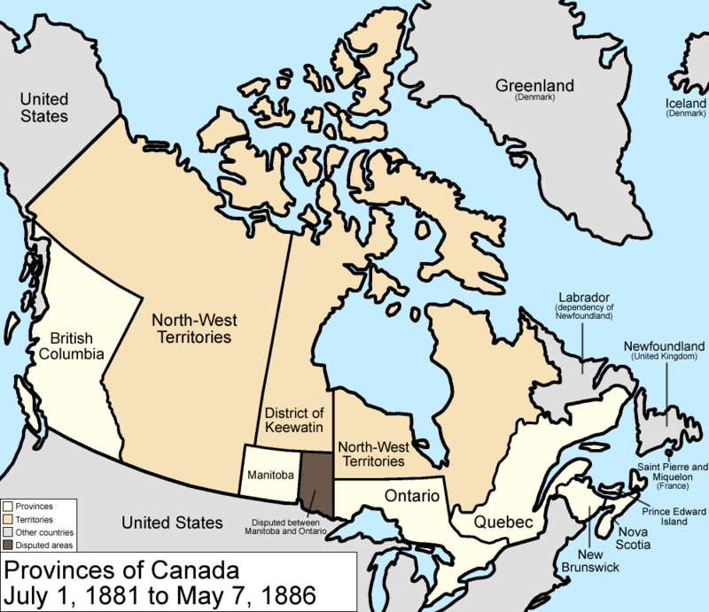

Slide 39
Canadian Confederation

Slide 40
Why Confederation?
War and expansionism in the U.S.
Fenian raids
British trade policy
Reciprocity with U.S. ends
Railway needs
British economic support fades

Slide 41
B. American Civil War, 1861-1865
Britain supported South
sold warships to Southern forces
Southern soldiers stage raids on Northern states out of Canada
BNA fear retaliation by Northern U.S. to get back at Britain

Slide 42
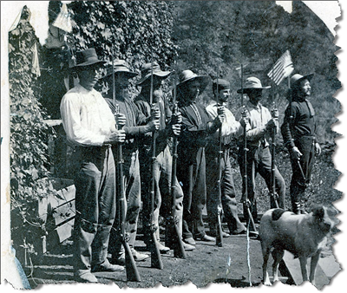
C. American Expansionism
Manifest Destiny promoted by some in the U.S.
God directed right to take over all of North America
1867 U.S. purchased Alaska from Russia ($26 m)
American settlers, railways, trade pressing West and surrounding Red River Settlement
Gold rush in BC drawing thousands of Americans into colony

Slide 43
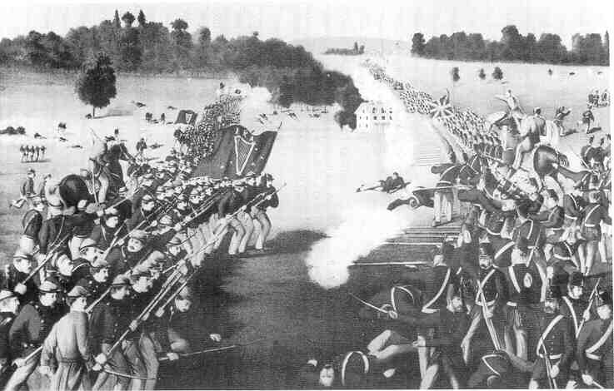
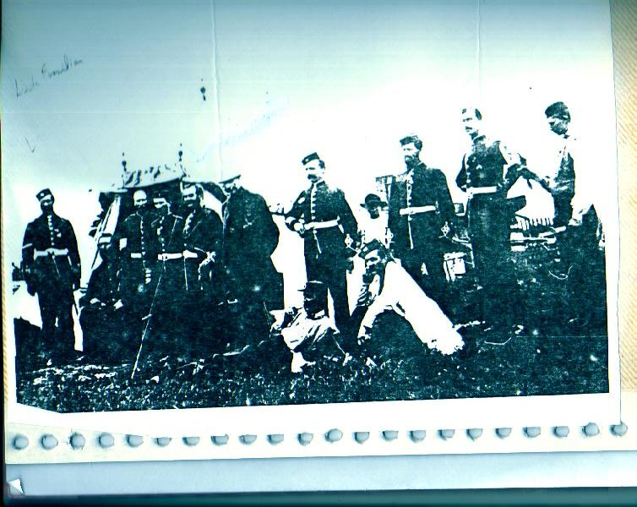
D. Fenian Raids
Fenians were American Irish who despised Britain
Fenians raided colonies along border
Settled in U.S. to escape British control in Ireland
Most were ex-civil war soldiers
Sought to free Ireland of British rule by capturing BNA colonies
U.S. government turned blind eye to raids
Notes:
Between 1866 and 1870, the Fenian raids of the Fenian Brotherhood, an Irish Republican organization who were based in theUnited States, on British army forts, customs posts and other targets in Canada, were fought to bring pressure on Britain to withdraw from Ireland. They divided Catholic Irish-Canadians, many of whom were torn between loyalty to their new home and sympathy for the aims of the Fenians. The Protestant Irish were generally loyal to Britain and fought with the Orange Orderagainst the Fenians. While the U.S. authorities arrested the men and confiscated their arms, there is speculation that some in the U.S. government had turned a blind eye to the preparations for the invasion, angered at actions that could have been construed as British assistance to the Confederacy during the American Civil War. There were five Fenian raids of note.

Slide 44
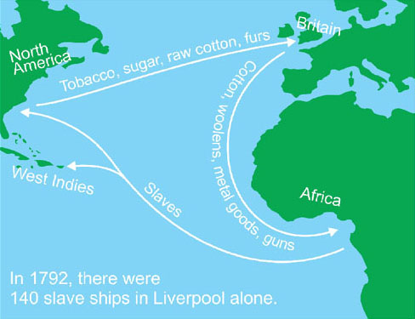
E. Trouble with British Trade
Before 1846, BNA colonies had favored trade with Britain
Special deal called “preference”
In 1846, Britain ended preference and now allowed goods from all countries without charging taxes
Caused financial pressure on colonies
In 1854, BNA entered into RECIPROCITY TREATY with U.S. for 10 years
U.S. ended treaty in 1865, BNA colonies suffered
Notes:
The Canadian–American Reciprocity Treaty of 1854, also known as the Elgin-Marcy Treaty, was a trade treaty between Great Britain and the United States, applying to British possessions in North America including the United Province of Canada, New Brunswick, Nova Scotia, Prince Edward Island, and Newfoundland Colony. It covered raw materials and was in effect from 1854 to 1865. It represented a move toward free trade, and was opposed by protectionist elements in the United States. After the conclusion of the American Civil War, these protectionist elements were joined by Americans angry at apparent British support for the Confederate States of America during the war, and the alliance was successful in terminating the treaty in 1866. The response in British North America was to confederate into the Dominion of Canada (1867), which was expected to open up many new economic opportunities inside Canada, and also unify the colonies against growing expansionist sentiments in the United States associated with the Alaska Purchase. Attempts by the Liberal Party of Canada to revive free trade in 1911 led to a political victory for Conservatives who warned that Canada would be swallowed up by its giant neighbor. Talk of reciprocity was put on hold for decades.

Slide 45
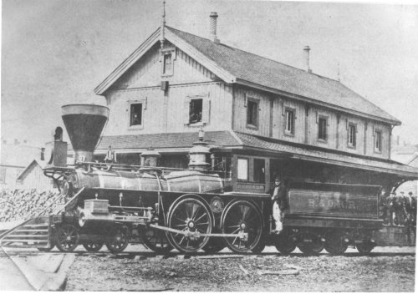
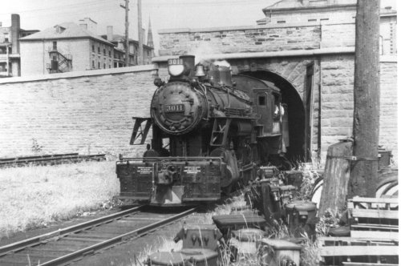
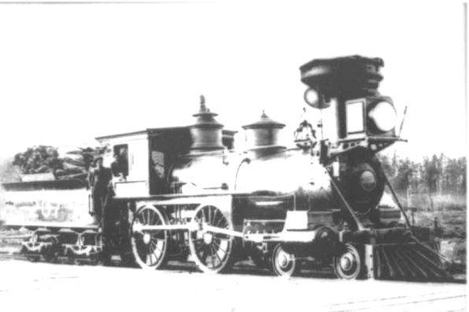
F. Need for Rail Links
Trade among colonies needed rail system
In 1850, only 106 km of line existed
Much of rail business going to Americans
Colonists sought to build own rail lines
Between 1850-1867, 3,570 km of line added
Grand Trunk Railway sought to join Canada West to Halifax
Expensive and nearly went bankrupt
Solution was uniting to share costs
Railway would improve communication and trade link
Increase security and defense of BNA

Slide 46
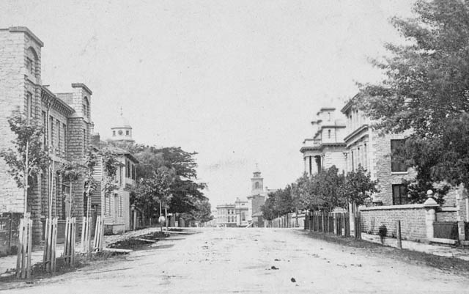
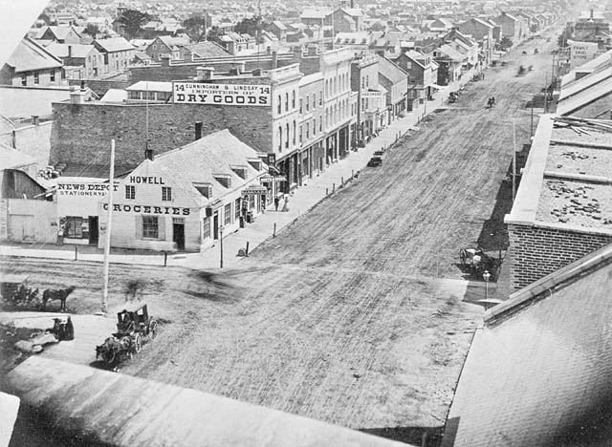
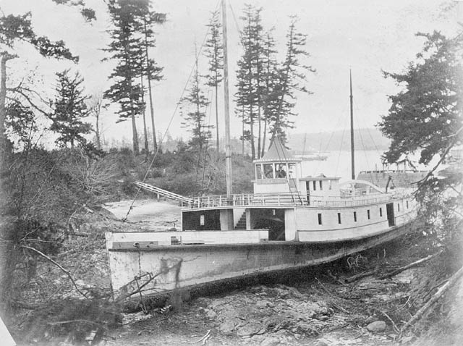
G. British Economic Support Fades
Britain looked at BNA colonies as great expense
Defense costs huge
Wanted colonies to pay own way and become independent
New attitude came at time of Fenian raids and U.S. westward expansion

Slide 47
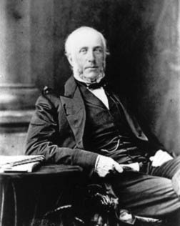
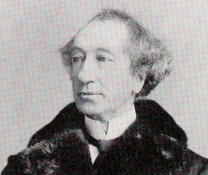
H. Political Deadlock
United Canada in 1860 had severe political deadlock
Government and opposition nearly even number of seats
Impossible to pass bills in Assembly or make new laws
Government ground to halt
George Brown
John A. Macdonald

Slide 48
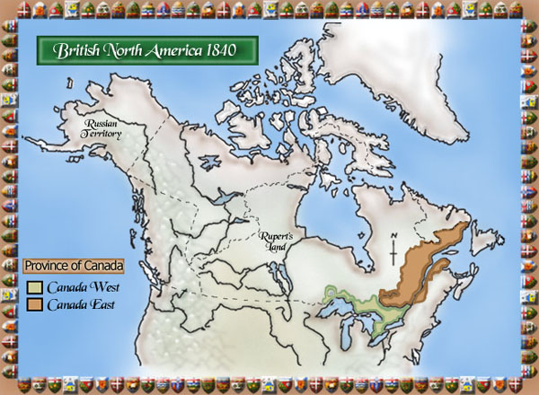
Political Deadlock
Between 1849-1864 twelve different governments in power: Political Deadlock
In 1864 Macdonald's government defeated
Instead of new election, sought to join forces with George Brown, leader of Clear Grits
Great Coalition was formed. It brought together the politicians of East and West Canada together despite differences
Intent was to form a larger nation that would include the other BNA colonies.

Slide 49
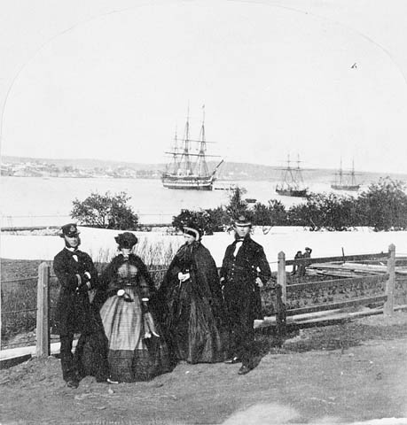
I. Maritime Union (end)
Many in Canada wanted colonies to unite— become free of British rule
Movement to join 4 Atlantic colonies into a Maritime Union separate from other colonies
Many wanted to stay British subjects
French Canadians feared end of the separate identity and right

Slide 50
Sources
http://eschoolbc.sd23.bc.ca/mod/book/tool/print/index.php?id=23478
Wikipedia

