Slide 1
Age of Napoleon
Chapter 18: Section 4

Slide 2
Early Years
Born in Corsica- French ruled island in the Mediterranean.
Age 9, sent to military school.
Showed great ambition and promise as a youth.
Eager to make a name for himself.
French Revolution
Rose quickly in the army.
Drove British forces out of port of Toulon
Leads expedition to Egypt to disrupt British, 1798.
Expedition is a disaster but he covers it up.
Used spies and censored the press.

Slide 3
Gaining Power
1799, moves from victorious general to politician.
Establishes the Consulate.
3 man governing board.
Another constitution is drawn up.
Napoleon soon took the title First Consul.
1800, Napoleon forces Spain to return Louisiana Territory to France.
1802, names himself consul for life.
1803, sells the Louisiana Territory for $15 million to the United States to fight its wars.

Slide 4
Becomes Emperor
Two years later, Napoleon decides to name himself Emperor of France.
Invites the pope to preside over his coronation.
Placed crown on his own head.
Owed his throne to no one but himself.

Slide 5
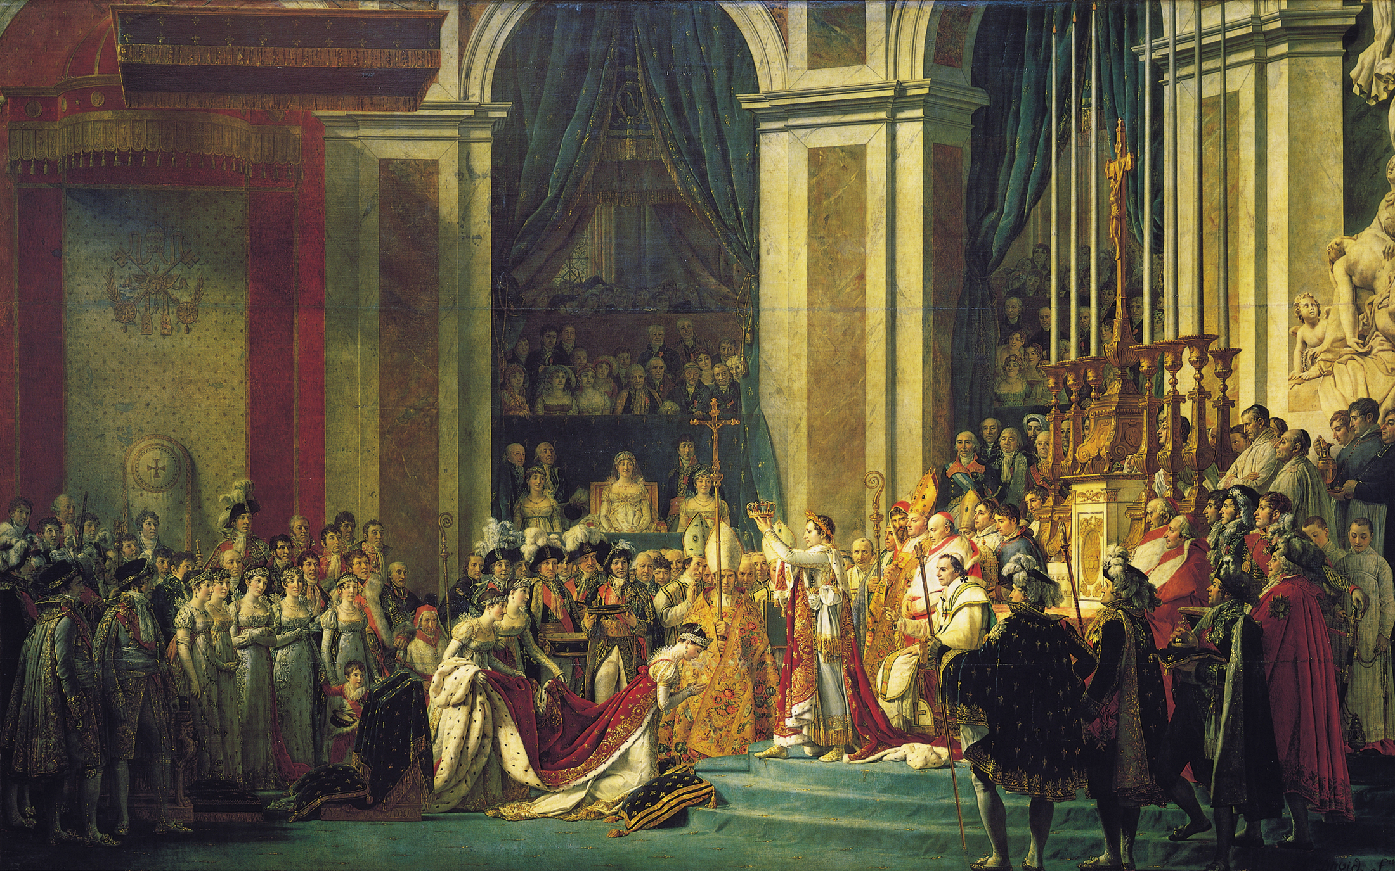

Slide 6
Reforms
Strengthened central government
Set prices
Built roads and canals
Established schools strictly controlled
Supported by all classes
Peasants got right to lands bought from church and nobles during the revolution.
Middle class had benefited most from revolution; enjoyed the peace after decades of chaos.
Created many jobs based on talent.

Slide 7
Building an Empire
Napoleon redraws the Map of Europe
Annexed the Netherlands, Belgium, and parts of Italy and Germany.
Abolished the Holy Roman Empire.
Cut Prussian territory in half.
Used forcible diplomacy to accomplish
Remove rulers and replace them with relatives or friends.
Forced rulers of Austria, Prussia, and Russia to sign treaties.

Slide 8
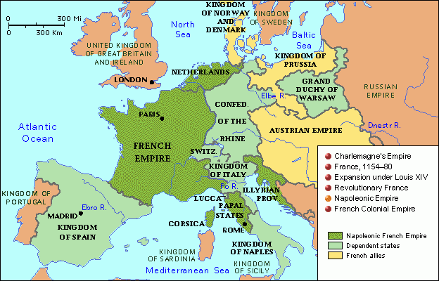

Slide 9
Napoleon Strikes Britain
1805, Napoleon plans to invade Britain.
Battle of Trafalgar, French fleet is smashed.
Invading Britain no longer an option.
Napoleon decides to go after British commerce.
Wages economic war through the Continental System.
More harmful to France than Britain.
Britain’s navy was too powerful and kept important trade routes open.
Trade restrictions create a scarcity of goods in Europe, sent prices soaring, and intensified resentment against French power.

Slide 10
Continental System
GOAL → to isolate Britain and promote Napoleon’s mastery over Europe.
Berlin Decrees (1806)
British ships were not allowed in European ports.
“Order in Council” (1806)
Britain proclaimed any ship stopping in Britain would be seized when it entered the Continent.
Milan Decree (1807)
Napoleon proclaimed any ship stopping in Britain would be seized when it entered the Continent.
These edicts eventually led to the United States declaring war on Britain → WAR OF 1812.

Slide 11
Decline of Napoleon
Nationalism works against Napoleon
Europeans saw French as foreign oppressors.
Leads to revolts.
Spain resisted Napoleon’s reforms to the Catholic church and responded with guerrilla warfare.
Encouraged Austria to resume hostilities as well.

Slide 12
Invasion of Russia
Tsar Alexander I withdraws support of the continental system after its failure and after the Grand Duchy of Warsaw got too large in the west.
Napoleon responded by invading Russia with 600,000 troops and 50,000 horses.
Russians retreat to avoid battle and scorch earth behind them.
Left French hungry and cold as winter set in.
September, Napoleon reaches Moscow.
Realized he wouldn’t be able to feed or supply his army.
Turned his army homeward in October.
1,000 mile retreat
Fewer than 20,000 soldiers survived.

Slide 13
New Alliances
Russia, Britain, Austria, and Prussia form an alliance against France.
1813, they defeated Napoleon in the Battle of the Nations at Leipzig.
One year later, Napoleon abdicated power.
Exiled by victors to Elba, an island in the Mediterranean.

Slide 14
Napoleon Rises Again
Louis XVIII does poorly and is unpopular.
Napoleon escapes and marches across Europe to Paris.
Soldiers flock to him.
Napoleon reaches Paris and takes it without firing a single shot.
Napoleon reassembles an army.
Met by allied forces of Britain and Prussia on June 18, 1815 near the town of Waterloo in Belgium.

Slide 15
Congress of Vienna
Meant to restore order and stability to Europe.
Austria and Prussia wanted to split up France for themselves, but Britain wouldn’t allow it.
Reason why Britain didn’t try to take anything from the United States after the War of 1812.
Wanted to keep France weak.
North of France, Belgium and Luxembourg were added to Holland to create the Netherlands.
Prussia got lands along the Rhine River.
Austria reasserted control over northern Italy.
Failed to see how nationalism would shake Europe and Latin America.

Slide 16
Quotes
Napoleon’s presence was “worth 40,000 troops.”
Napoleon called a “Corsican ogre”.
Napoleon on the French Revolution, “Since one must take sides, one might as well choose the side that is victorious, the side which devastates, loots, and burns. Considering the alternative, it is better to eat than be eaten.”
Napoleon, “I grew up on the field of battle and a man such as I, cares little for the life of a million men.”

