Slide 1
Atomic Bomb

Slide 2
Argument against using it.
It was used as a warning for the Soviets.
Japan was about to surrender.
Japan would have surrendered if they could have kept their emperor.

Slide 3
Fundamentally immoral
“As American Christians, we are deeply penitent for the irresponsible use already made of the atomic bomb. We are agreed that, whatever be one's judgment of the war in principle, the surprise bombings of Hiroshima and Nagasaki are morally indefensible.”

Slide 4
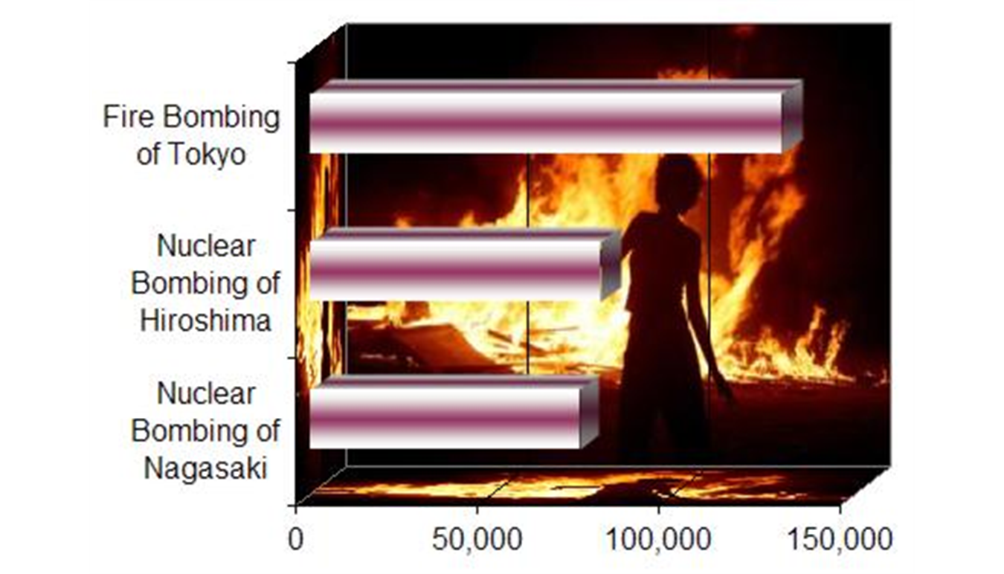
Continuation of Previous Behavior
Fire-bombings of Tokyo

Slide 5
Bombings as War Crimes
In the documentary The Fog of War, former U.S. Secretary of Defense Robert S. McNamara recalls General Curtis LeMay, who relayed the Presidential order to drop nuclear bombs on Japan, said:
"If we'd lost the war, we'd all have been prosecuted as war criminals." And I think he's right. He, and I'd say I, were behaving as war criminals. LeMay recognized that what he was doing would be thought immoral if his side had lost. But what makes it immoral if you lose and not immoral if you win?

Slide 6
Militarily Unnecessary
Eisenhower
“In 1945 Secretary of War Stimson, visiting my headquarters in Germany, informed me that our government was preparing to drop an atomic bomb on Japan. I was one of those who felt that there were a number of cogent reasons to question the wisdom of such an act. During his recitation of the relevant facts, I had been conscious of a feeling of depression and so I voiced to him my grave misgivings, first on the basis of my belief that Japan was already defeated and that dropping the bomb was completely unnecessary, and secondly because I thought that our country should avoid shocking world opinion by the use of a weapon whose employment was, I thought, no longer mandatory as a measure to save American lives.”

Slide 7
Militarily Unnecessary
Fleet Admiral Chester W. Nimitz
“The Japanese had, in fact, already sued for peace. The atomic bomb played no decisive part, from a purely military point of view, in the defeat of Japan."
Fleet Admiral William Leahy
“The use of [the atomic bombs] at Hiroshima and Nagasaki was of no material assistance in our war against Japan. The Japanese were already defeated and ready to surrender because of the effective sea blockade and the successful bombing with conventional weapons... The lethal possibilities of atomic warfare in the future are frightening.”

Slide 8
State Terrorism
Historical accounts indicate the decision to use the atomic bombs was made in order to provoke a surrender of Japan by use of an awe-inspiring power. These observations have caused Michael Walzer to state the incident was an act of "war terrorism: the effort to kill civilians in such large numbers that their government is forced to surrender. Hiroshima seems to me the classic case."

Slide 9
Nagasaki Bombing Unnecessary
Came 3 days after Hiroshima
Full devastation was still unknown
Thus Japan didn’t comprehend what it meant.
Some argue the second bomb was “unnecessary”.

Slide 10
Arguments for:
Manhattan Project was expensive (needed to use the bombs)
Gave Japan clear warning

Slide 11
Preferable to Invasion
It is believed massive casualties on both sides would have occurred in Operation Downfall, the planned invasion of Japan.
Japanese were fighting more relentlessly the closer the fighting got to Japanese mainland.
Estimated American casualties to take Japan would be 250,000 to one million men.
Not including civilian or Japanese casualties.
200,000 Japanese deaths can be calculated for a short invasion of two weeks, and almost 3 million Japanese deaths if the fighting lasted four months.
Other estimates ranged from 5 to 10 million Japanese deaths.

Slide 12
Speedy End to the War Saved Lives
For China 100,000 to 200,000 died.
Fire-bombing of Tokyo killed over 100,000.
Robert P. Newman
Argued that each month that the war continued would have produced deaths of 'upwards of 250,000 people, mostly Asian but some Westerners.’

Slide 13
Part of Total War
Father John A. Siemes, professor at Tokyo's Catholic University (also an eyewitness):
“We have discussed among ourselves the ethics of the use of the bomb... It seems logical to me that he who supports total war in principle cannot complain of war against civilians.”

