Slide 1
Ancient Rome and Christianity
Pre-IB World History: Chapter 5

Slide 2
Background
Rome- “the city on seven hills”
Etruscans- people living just north of Rome.
Developed the arch (adopted by the Romans)
Drive out Etruscan ruler and establish res publica
“that which belongs to the people”
A republic- to keep any individual from too much power.

Slide 3
People
Patricians
Land holding upper class.
At first, were the only ones to be government officials.
Plebeians
Farmers, merchants, and artisans
Most of the population
Eventually allowed to serve as consuls, not be taxed, and become senators.
Laws of the Twelve Tables- made it possible for the first time for plebeians to appeal a judgment handed down by a patrician judge.

Slide 4
Military
Legion
Basic military unit for the Romans
Mixed rewards and punishment
Courage in action won praise and gifts
Units that fled were punished by having one out of every ten men killed
Roman citizens made good soldiers because they were brought up to value loyalty, courage, and respect for authority.

Slide 5
Punic Wars
First Punic War
Rome defeats Carthage and won the islands of Sicily, Corsica, and Sardinia.
Second Punic War
Hannibal wants revenge
Attacks from north (loses a third of his army)
Surprises Romans
Wins battle after battle for 15 years but never captured Rome itself
Third Punic War
Rome in revenge completely destroys Carthage
Survivors are killed or sold into slavery
Salt was poured over the earth

Slide 6
Republic
The use of representatives.
Rome’s case, a senate.
Senate held most power early in Rome’s history
Julius Caesar
Successful military commander
Defeats Pompey and his supporters who feared he was becoming too powerful.
Became the first absolute ruler
Enemies stabbed him to death in March of 44 B.C.

Slide 7
Republic
Augustus become the first Emperor of Rome
He ordered a census to determine who should be taxed.
He allowed cities and provinces some self-government.
He created an efficient civil service.
Emperors after him would vary
Two most evil Caligula and Nero

Slide 8
Empire
Adopted system of Imperialism
For the most part, life under Roman rule was not bad.
States maintained a lot of control still
Could keep local governments
Could keep religions and customs
allowed to worship their own Gods as long as they also honored Roman gods.

Slide 9
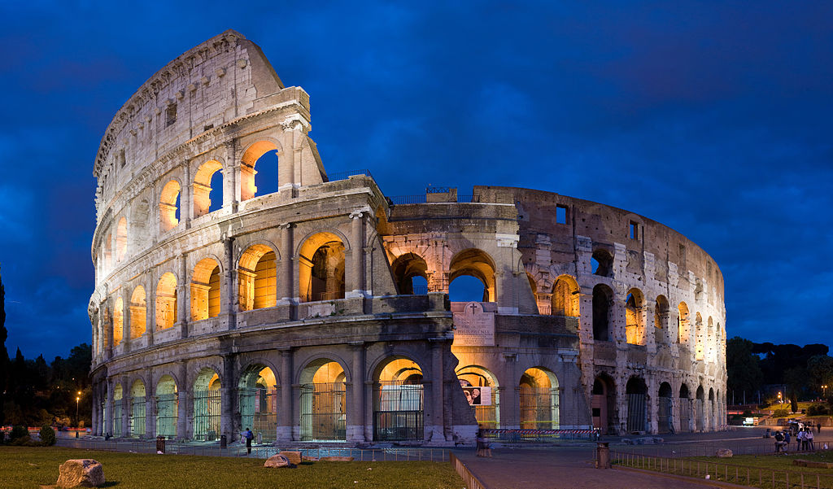

Slide 10
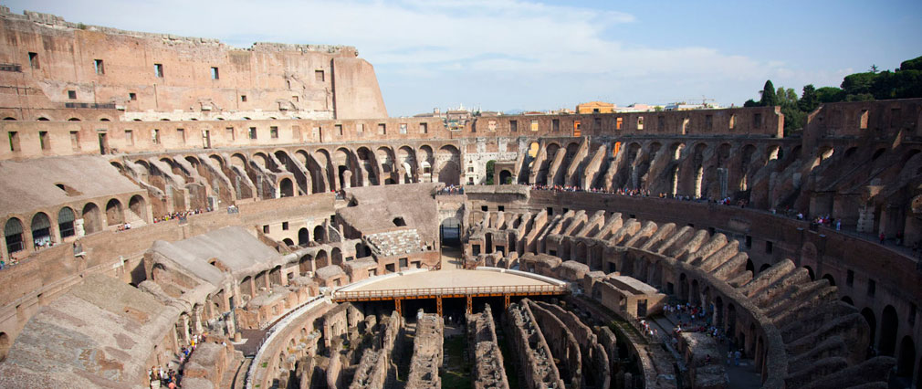

Slide 12
Entertainment
The Colosseum
Gladiators
Wild animals
Hunts
Man vs. Beast
Chariot racing
Sea battles
Executions
Re-enactments
Dramas

Slide 13
Achievements
Architecture
Utilized concrete
Developed the rounded dome
Laws
Two Codes
Civil law- applied to Roman citizens.
Law of nations- applied to people under Roman control, both citizens and non-citizens.
Science
Romans rely on Greeks for scientific advancements

Slide 14
Rise of Christianity
Rome takes control of Israel
Some willing to reluctantly live under Roman rule
Zealots were not and called Jews to revolt
Many expected the messiah to come liberate Israel
Jesus is very different than what is expected.
Christianity spreads
Initially Christians are persecuted
Crucified, stoned, fed to lions
Constantine issues the Edict of Milan
Grants religious freedom to Roman citizens
Theodosius makes Christianity the official religion

Slide 15
Attraction of Christianity
Jesus’ teachings receive widespread support
Love
Compassion & forgiveness
Eternal life
Moderation appealed to Greek philosophies (Stoics)
Christianity promoted equality
Followers of Jesus were persistent
Christians become martyrs
Earn respect and sympathy

Slide 16
Rome Declines
Political instability
26 emperors in 50 years
Economic problems
High taxes
Farmland over-cultivated
Huns begin pushing into Germanic lands
Caused Germanic people to begin attacking Roman territory.

