Slide 1
Immigration’s impact on Indigenous People
Modern Nations
IB History

Slide 2
Impact on Indigenous
This will blend with many other aspects we have or will discuss in this unit.

Slide 3
Impact on Indigenous
Negative impact
Doctrines of Social Darwinism and Progressivism
Opening of new territories
Development of railroads and settlements, and in some areas, a need for labor.
Displacement, starvation and, in some cases, annihilation of the Native American population.
Attempt to assimilate through Indian Schools

Slide 4
Indigenous in Canada
Canadian Pacific Railway brought more white settlers
Governments set up were not based on aboriginal foundations
Epidemics devastate the population
Contributed to near extinction of bison
With bison gone, the First Nations agree to treaties with Canadian officials for food.
Lieutenant-Governor Edgar Dewdney cut rations to save money
Between 1880-1885, 3,000 aboriginals starve to death
Big Bear refused to sign Treaty 6 until starvation among his people forced his hand in 1882

Slide 5
Impact on Indigenous
Governments used different means to achieve these goals:
Relocations
“unequal treaties”
Warfare and extermination campaigns
"Everything that they used to get them to sign treaties, I think was illegal in a lot of ways--browbeating, brainwashing, and then on the other hand telling them, 'If you sign this treaty, you’re not going to ever have to work or hunt again; we’ll take care of you.' Everything will be provided. Every year you’ll get so much money to buy your needs, your pots and pans, but we’ll also have food coming in every month, or once a year for you. The other alternative is: 'We’re going to drive you all the way to the Rocky Mountains where you’re going to starve to death and we’ll never have to worry about you again.' Those were the conditions that were being talked about, and sometimes I think they might have done that." – Dr. Elden Lawrence

Slide 6
Fort Laramie Treaty of 1868
Agreement between the United States and the Oglala, Miniconjou, and Brulé bands of Lakota people, Yankton Dakota, and Arapaho Nation.
Guaranteed the Lakota ownership of the Black Hills
Land and hunting rights in South Dakota, Wyoming, and Montana. The Powder River Country was to be henceforth closed to all whites.
The treaty ended Red Cloud's War.

Slide 7
Black Hills War
Between 1876 and 1877 involving the Lakota Sioux and Northern Cheyenne against the United States.
Gold was discovered in the Black Hills
U.S. cannot keep flood of miners out
Grant Administration does not want to laugh war without provocation
Grant tells Indian agents the Lakota and Cheyenne must be on the reservation by January 31, 1876 not leaving much time.
Indians for the most part comply, but are said to have not.
Begins the Great Sioux War of 1876

Slide 8
Battle of Little Bighorn
General George Custer leads expedition (7th Calvary) across the Great Sioux Reservation
Indian uprisings
Gold found in the Black Hills
Prospectors made their way to mine
Attacked by Indians
Custer sent to check it out
Custer was warned of a strong Indian army which he disregarded.
Gives orders to attack tribe members trying to warn village
Is unaware of the size or strength
Backfires and Custer’s detachment is wiped out (Except one horse)

Slide 9
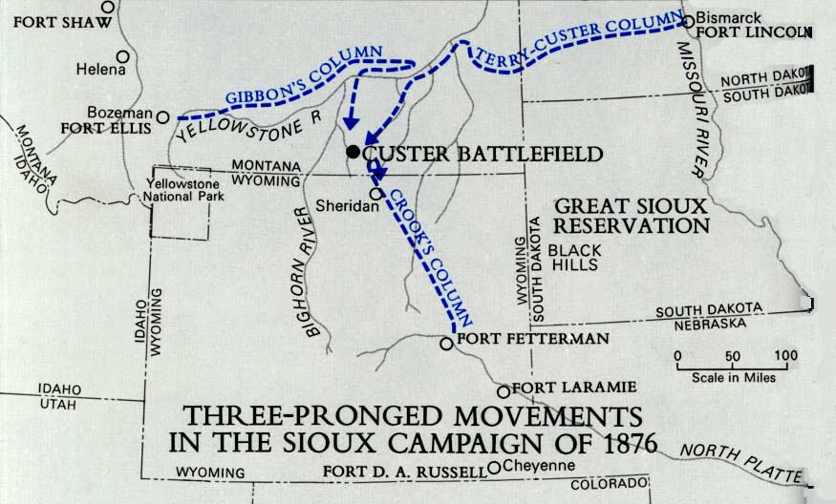

Slide 10
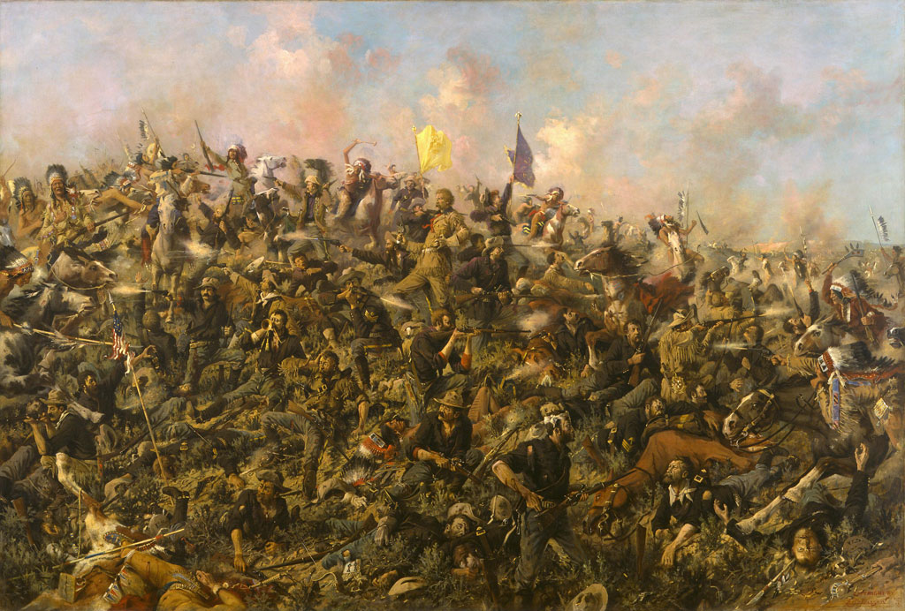

Slide 11
Black Hills War
U.S. changes strategy and puts pressure on peaceful Indian bands
“Sell or starve”
cut off all rations for the Sioux until they terminated hostilities and ceded the Black Hills to the United States
U.S. officially annexed Sioux land and permanently established Indian reservations
Sitting Bull

Slide 12
Wounded Knee Massacre
Also called the Battle of Wounded Knee
Called this by white people
Indians call it a massacre
Ghost Dance
Bring back ancestors, buffalo, and make the white man go away.

Slide 13
Indian Schools
Canada, Indian Act of 1876
Increased use of Indian schools in Canada
Run by churches, primarily Catholic and Anglican schools
Goal to assimilate Indians by taking them out of their culture and enfranchising them (speak, read, write)
American Indian Schools
First established by Christian missionaries to offer an opportunity of an education for children
"kill the Indian and save the man.“- Henry Pratt
Bureau of Indian Affairs gets involved
Wanted to change appearance and language
Wanted to remove every part of old culture

Slide 14
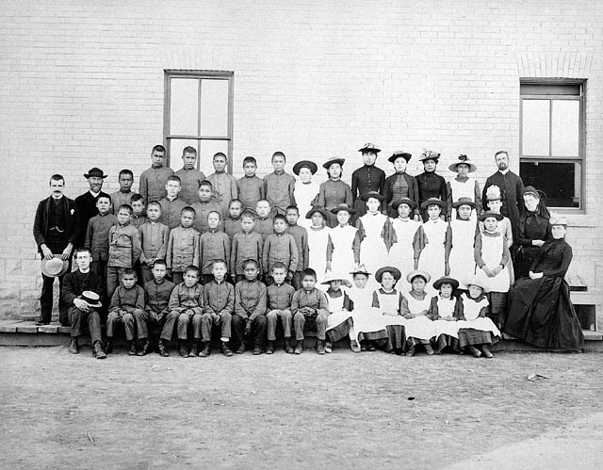
St. Paul's Indian Industrial School, Middlechurch, Manitoba, 1901

Slide 15
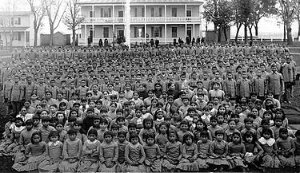
Pupils at Carlisle Indian Industrial School, Pennsylvania (c. 1900).

Slide 16
“[Long hair] was the pride of all Indians. The boys, one by one, would break down and cry when they saw their braids thrown on the floor. All of the buckskin clothes had to go and we had to put on the clothes of the White Man. If we thought the days were bad, the nights were much worse. This is when the loneliness set in, for it was when we knew that we were all alone. Many boys ran away from the school because the treatment was so bad, but most of them were caught and brought back by the police.”
Lone Wolf of the Blackfoot tribe

