Slide 1
Industrial Revolution
Chapter 19

Slide 2
Origins of the Industrial Revolution
Starts in Britain
Why?
Agricultural Revolution
Crop rotation
New crops
New tools
Increases food production which lowers prices (disposable income)
Population Increase
Small country- transportation relatively short distances

Slide 3
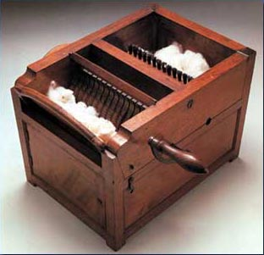
New Inventions
Cotton Industry blooms
Cotton gin
Steam Engine
Powered by coal
Iron Industry takes off
Railways
Industrial Factories

Slide 4
Working Conditions
12 to 16 hour days
No scheduled breaks
Needed permission from factory owners
Unsafe working conditions
Workers were exhausted
Often lose a finger or limb
Did not receive compensation
Textile mills and mines workers breathed bad air
Cause them to get sick and damaged lungs
Sick or injured workers would lose their jobs

Slide 5
Child Labor
Why?
Low wages- 1/6 of adult male workers
Small bodies
Nimble fingers
Children worked on farms so it was accepted and families needed the wages.
Industries
Mines
Textile factories
Discipline
“Factory acts” were passed in early 1800s
Reduce work day and ages of child labor
More acts past in 1830s and 1840s to enforce earlier acts and require child workers be educated.

Slide 6
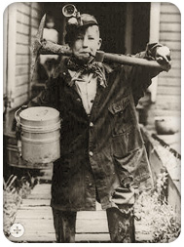

Slide 7
Women’s Labor
Why?
Lower wages- half of what men made
Industries:
Textiles
Mining
Thought women could adapt to factories better than men.
Easier to manage
Burdens
Out of home for 12 or more hours a day
Had to feed families and clean still
Coped with problems of sickness and injury
1830s and 1840s- laws passed to shorten workday.

Slide 8
