Slide 1
Leaders
Modern Nations

Slide 2
Economic and Political Aims
Colonialism
Until late 1800s, Britain was most powerful in Latin America
Military exploits were limited
Argentina bore the brunt
Malvinas/Falklands
Commercial and financial expansion
Great Britain owned over half of Latin America’s foreign investment and debt
Great Britain was a model of progressive economics and politics
Men adopted British clothing
U.S. involvement began to displace British in 1890s
U.S. depression spurs desire for overseas markets
Alfred Thayer Mahan
Calls for stronger navy
Canal linking Atlantic and Pacific
Calls for annexation of Hawaii

Slide 3
Economic and Political Aims
U.S. intervention in Cuba
1898 United States declares war on Spain and intervenes in Cuba
Invaded Puerto Rico and Philippines
War lasted only a few weeks
“Yellow journalism” reports of Spanish atrocities in Cuba
U.S. public opinion favors “rescuing” Cuba from Spain
Outcome of war benefits U.S. economic and strategic interests
Cuba remained a protectorate for 35 years
Platt Amendment allows United States to intervene in Cuban affairs
Philippines
(i) Commercial gateway to Asia
(ii) Governed directly until World War II

Slide 4
Economic and Political Aims
Theodore Roosevelt
War in Cuba boosted his political career
As president, acquired U.S. base in Panama
(i) Helped separate Panama from Colombia
(ii) Bought canal rights from new Panamanian government
(iii) Deal secured with no native Panamanian participation

Slide 5
Economic and Political Aims
U.S. attitudes toward Latin Americans shaped by racial prejudice
Rudyard Kipling’s “white man’s burden”
Duty of whites to civilize non-Europeans
Idea influenced U.S. mission in Latin America
Senator Alfred Beveridge – “God has marked the American people as His chosen nation to finally lead the regeneration of the world”
Roosevelt Corollary
Update to Monroe Doctrine
U.S. military would intervene around the region
U.S. newspapers caricature Latin American nations
Naughty schoolboys
“Little black Sambo”
Intervention needed to discipline Latin America

Slide 6
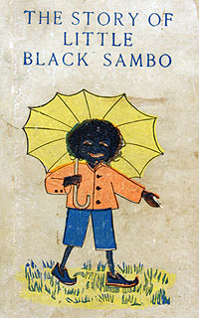
Notes:
Sambo is a South Indian boy who lives with his father and mother, named Black Jumbo and Black Mumbo, respectively. Sambo encounters four hungry tigers, and surrenders his colourful new clothes, shoes, and umbrella so they will not eat him. The tigers are vain and each thinks he is better dressed than the others. They chase each other around a tree until they are reduced to a pool of melted butter. Sambo then recovers his clothes and his mother, Black Mumbo, makes pancakes out of the butter.

Slide 7
Economic and Political Aims
Pan-American Union
Promote free trade
Initially composed of ambassadors to the United States
Pan-American conferences
United States promoted trade
Latin American countries voiced dismay at U.S. interventions
Protests came to a head at Havana Conference of 1928

Slide 8
Economic and Political Aims
Latin American protest
United States had intervened in Cuba, Puerto Rico, Panama, as well as in Nicaragua, Haiti, and the Dominican Republic
By late 1920s, United States engaged in a war with Nicaraguan rebels
Led by Augusto Sandino
Accused United States of imperialism
Became hero to many Latin Americans
Latin American writers protest
Darío condemns “godless” Roosevelt
José Martí defends “our America”
(i) Cuba’s greatest patriotic hero
(ii) Exiled from Cuba at age 16
(iii) Edited magazine in Mexico
(iv) Taught in Guatemala
(v) Organized Cuban independence
(vi) Wrote on the United States from New York
José Enrique Rodó
(i) Uruguayan essayist
(ii) Wrote Ariel (1900)
(iii) Accused U.S. culture of crass materialism
Rise of cinema helped bind Latin America to United States

Slide 9
Economic and Political Aims
Neocolonial model shattered by depression
U.S. market crash in 1929
Demand for Latin American exports plummeted
Importation of progress halted

Slide 10
Theodore Roosevelt- Successes
Successes- “Speak softly and carry a big stick”
Builds the Panama Canal
Panama wanted independence from Colombia (US supported Panama)
In return, Panama gave permission to build canal
The Square Deal
conservation of natural resources, control of corporations, and consumer protection
Created U.S. Forest Service- Created 150 national forests, and 5 national parks.
The Sherman Antitrust Act - Filed 44 antitrust suits
Prohibits anti-competitive business activity
Successfully mediated a treaty between Japan and Russia during the Russo-Japanese War
1902 Coal Strike
The Meat Inspection Act

Slide 11
Theodore Roosevelt- Failures
Failures
Did not attempt to pass much he couldn’t get done
Loses election of 1912 to Woodrow Wilson
Ran as apart of the Progressive Party
Civil rights for African-Americans
Supported healthcare for all Americans
The Sherman Antitrust Act - Unable to slow the merger movement in business

Slide 12
Wilfrid Laurier- Successes
Successes
Seventh Prime Minister of Canada from July 11, 1896 to October 6, 1911.
Liberal politician (more on the side of French)
Wanted to create national harmony (tried to unite the divide)
resisted every effort the British Empire made toward federation of the empire
Manitoba Schools Compromise
Public funding was taken from Catholic Schools
Laurier proposed funding if there were enough students to warrant it, on a school-by-school basis
Construction of a second transcontinental railway
In 1905, Laurier oversaw Saskatchewan and Alberta's entry into Confederation

Slide 13
Wilfrid Laurier- Failures
Supported trade reciprocity (free trade) with U.S.
Alienated liberal businessmen and denounced by conservatives
Failed in Alaska boundary dispute
World War I
GB wanted help from Canada in the war
Prime Minister Borden proposed Conscription (a draft) in 1917
Laurier (leader of the liberal party then) at the time did not agree and fought to stop it but failed

Slide 14
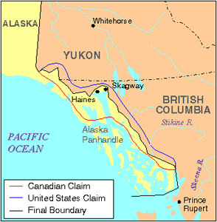

Slide 15
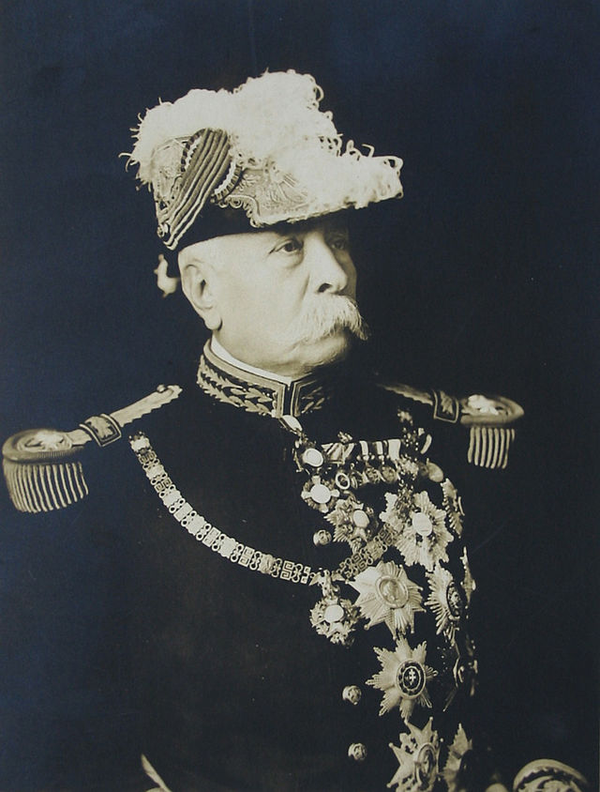
Porfirio Díaz
Seizing power in a coup in 1876, Díaz and his allies ruled Mexico for the next thirty-five years, a period known as the Porfiriato until 1911.
Founded the rurales, to secure rural areas for foreign investors
Foreigners owned about one-quarter of Mexico’s land
Foreign companies owned silver and oil concerns

Slide 16
Porfirio Díaz- Successes
Epitome of neocolonial dictatorships in Latin America
Maintained appearance of constitutionality, but managed elections to keep himself and allies in power
Circle of technocratic advisers called “científicos”, influenced by positivism (rejected metaphysics and theology)
Value of import/export trade rose ten times
Times were great for the “halves” but not as much for the “halve nots”
Curbed threats from caudillos by crushing them or buying them off
Bureaucracy created middle class jobs
“Pan o palo,” or “bread or stick”
Mexican rail system- 398 to 15,360 miles of rail in 2 terms
Wanted to make Mexico visually appealing
Created monument-lined avenues
Removed indigenous people from downtown Mexico City so country would look better to foreign visitors

Slide 17
Porfirio Díaz- Failures
Failures
Failed to crush a rebellion in Chihuahua led by Pancho Villa
More rebellions break out and Diaz resigns and flees to France.

Slide 18
Latin American Leader
Students will choose a Latin American leader during between the 1860s and 1920s.
Research the effect they had.
What their aims and goals were.
How they went about accomplishing their aspirations.

