Slide 1
Martin Luther King Jr. & Malcom X
Civil Rights

Slide 2
Civil Rights Movement Fractures
Mississippi Freedom Summer of 1964
Campaign of voter registration
Northern white students come to help the campaign
SNCC (Student Nonviolent Coordinating Committee) field workers resent the newcomers
Claimed they were “fly by freedom fighters”
Many took jobs local blacks had done.
Started carrying guns b/c they lost faith as violence cont’d
Didn’t think gov. was doing good enough to protect civil rights workers.
Mississippi Freedom Democratic Party (MFDP)
Backed President Johnson
Johnson was worried about losing white support in the South
Wasn’t worried about losing black support
MFDP pressured to agree to an all-white Democratic delegation
Martin Luther King Jr. supported this but many SNCC members viewed this as betrayal.
King felt confident the non-violence campaign would cont.

Slide 3
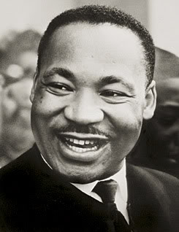
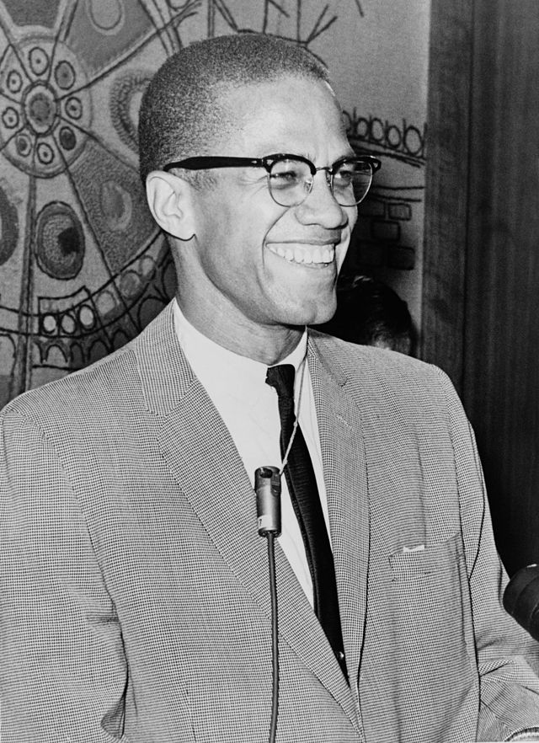
Key Figures of the Movement
Martin Luther King Jr.
Malcom X

Slide 4
Key Figures of the Movement
Martin Luther King Jr.
Malcom X
Main leader of the American civil rights movement,
A political activist and a Baptist minister, and was one of America's greatest orators.
In 1964, King became the youngest man to be awarded the Nobel Peace Prize (for his work as a peacemaker, promoting nonviolence and equal treatment for different races).
On April 4, 1968, King was assassinated in Memphis, Tennessee.
In 1952, renamed himself X to signify the loss of his African heritage (originally Little).
Converted to Nation of Islam in jail in the 50s, became Black Muslims' most dynamic street orator and recruiter.
Black Power movement built on his beliefs; separationist and nationalist impulses to achieve true independence and equality.
Murdered in 1965 by his own people who felt he wasn't representing them properly.
Stopped seeing whites as “devils”

Slide 5
Key Figures of the Movement
Martin Luther King Jr.
Malcom X
Grew up in Atlanta where his father and grandfather were ministers.
Influenced by Ghandi
Tactics
Peaceful demonstrations
Marches, boycotts, protests, and speeches.
Impact
Influential in the demonstrations leading to civil rights legislation
Montgomery Bus Boycott, Birmingham Campaign, Children’s Campaign, and “I Have a Dream” speech.
Very rough childhood.
Expelled from school, life of drugs, pimping and gambling until jailed for burglary in 1946.
Tactics
Blacks take control of own lives
Stop “begging” the system for “jobs, food, clothing and housing”.
Predicted racial warfare
“slaughter for this sinful white world.”
Criticized non-violent protest & working with whites
Impact
Emboldened blacks and created racial pride
Scared some whites
Read pg. 147 of IB Civil Rights Movement book:
Malcom X and Martin Luther King

Slide 6
“Black Power”
Malcom X inspired which voiced anger and bitterness of black Americans
For some it meant “black is beautiful” & others “black militant”.
Changed directions after Malcom’s death
Stokely Carmichael took lead
Opposed Vietnam War
Martin Luther King Jr.
Supported creating racial pride
Opposed call to violence and exclusion of whites
Impact
Helped promote self-reliance and racial pride
Appealed to black business- clothes, ‘soul’ music, and literature.
Afro hairstyles, “Say it loud - I’m black and I’m proud” – James Brown
Helped rid feelings of white supremacy and that blacks were inferior
Black Panthers- violent side of black power

Slide 7
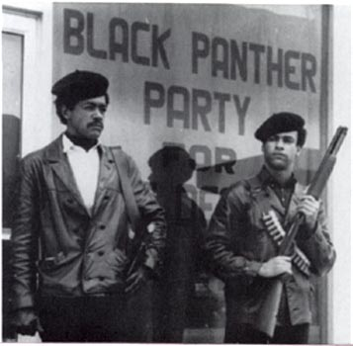
Black Panthers
Initial aim was to monitor the behavior of Oakland police.
Favored armed revolts and openly displayed firearms
Received much of the media coverage though they only ever had a few thousand members
FBI director, J. Edgar Hoover called them internal securities biggest threat.
Infiltrated by secret agents and able to
Led to hundreds of arrests, 30 deaths in ambushes.
By 1970, most of the leaders were dead or imprisoned

Slide 8
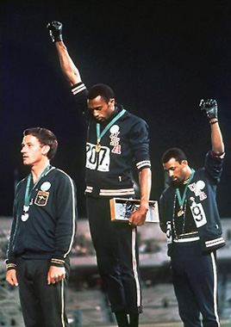

Slide 9
Radical African American Activism
More harm than good?
Background:
By 1965, the Civil Rights Movement was at its peak.
Passage of the Civil Rights Act of 1964 and Voting Rights Act of 1965
Dr. King receipt of the Nobel Peace Prize in 1964
Dr. King enjoyed the support of President Lyndon Johnson and his willingness to make civil rights a priority.

Slide 10
Radical African American Activism
More harm than good?
Irrelevant argument:
Dr. King’s base of support among African Americans had always been located in the South and was unlikely to grow in the urban West and North.
Dr. King’s emerging opposition to the Vietnam War was beginning to damage his relationship with President Johnson and may have led to his rejection among many mainstream whites who had supported, or at least not opposed, his civil rights initiatives.
Reforms emphasized by Dr. King (voting rights, integration of public accommodations etc.), achieved through court decisions and legislation, had been largely achieved by 1965 and thus the momentum for his efforts was likely to fade.

Slide 11
Radical African American Activism
More harm than good?
More harm argument:
In the urban North and West, poverty, urban decay, and claims of police brutality, etc., were of more immediate importance to African Americans than the issues which Dr. King had emphasized. Thus, solutions supported by radical organizations and leaders were more appealing than the methods and proposals of Dr. King.
The urban riots (Watts 1965 and Detroit 1967) represented the growth of new civil rights issues that Dr. King had not addressed: black employment twice that of whites, the growth of poverty and unemployment in the black community, charges of police brutality, de-facto segregation, poor urban housing condition etc.
The advocacy of confrontation to the point of violence, along with black power and black nationalism, was causing a “backlash” among many whites who viewed the radical forces as a threat to their political and economic control as well as national unity.

Slide 12
MLK and Malcom X Comparison
Martin Luther King
Malcom X
______________________________________________________
____________________________________________________________
Background
Religious beliefs
Goal
Methods
Achievement
Place in history

