Slide 1
Civil Rights Movement
Civil Rights

Slide 2
IB Standards
Role of governments in civil rights movements in the Americas
African Americans and the Civil Rights Movement: origins, tactics and organizations; the US Supreme court and legal challenges to segregation in education; ending of the segregation in the South (1955-65)

Slide 3
Origins
Segregation (Jim Crow laws)
Classrooms
Bathrooms
Theaters
Train cars
Lynchings and violence
Inequality (Jim Crow laws)
Wages
Barred from juries and legislatures
Disenfranchisement

Slide 4
Tactics
Protests
Boycotts
Montgomery Bus Boycott
Marches
Children’s Crusade
Speeches
“I Have a Dream” Speech- Martin Luther King Jr.
Litigation- court cases
Brown v. Board of Education Topeka, 1954
Defense through violence (Black Panthers)

Slide 5
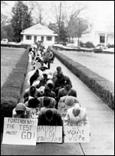
Protest march for voting rights in McComb, Mississippi. Courtesy, McCain Library and Archives, University of Southern Mississippi

Slide 6
Montgomery Bus Boycott
1955
Took place for more than 370 days when the black residents of Montgomery, Alabama, refused to ride the buses that would not allow desegregation.
It was prompted by Rosa Parks's refusal to give up her seat to a white passenger.
Organized by Dr. King and the MIA. Though tens of thousands walked for 12 months, what forced the buses to desegregate was not the boycott but a Supreme Court decision.

Slide 7
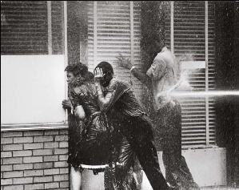
Birmingham Campaign
Martin Luther King, Jr., James Bevel, Fred Shuttlesworth
Birmingham was very racially divided both legally and culturally.
“Project Confrontation”
Children’s Campaign

Slide 8
Birmingham Campaign
“Project Confrontation”
March to desegregate businesses to employ blacks and integrate black customers
Demonstration was met with batons, dogs, and police violence.
King given an injunction to call off the campaign
Feels God tells him to disobey the immoral, man-made law
Marches to city hall and is arrested.
Children’s Crusade
1963, King led a march with the children in the front
clearly aware that they would be attacked.
Pictures of police using German Shepherd dogs against teenagers appeared on TV stations and in newspapers.
This draws sympathy as many Americans see children being hurt by police.

Slide 9
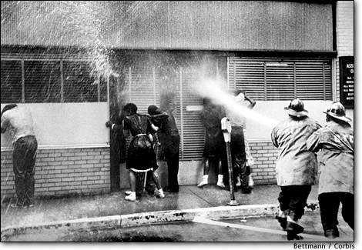
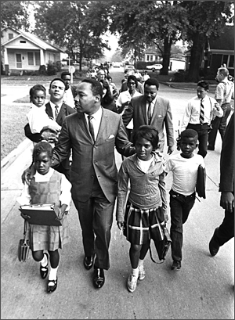
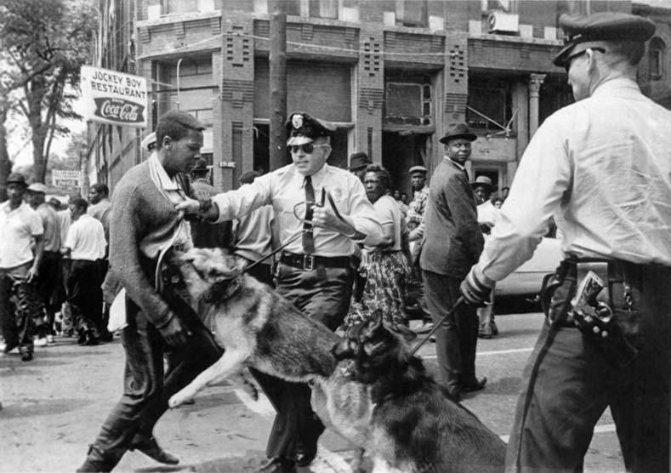

Slide 10
Birmingham March

Slide 11
Impact of Birmingham
50 other cities in the south agreed to desegregation laws to avoid chaos of Birmingham.
100,000 people demonstrated across the US
Pushed President Kennedy to act
Called black leaders together
“There was never any more skillful manipulation of the news media than there was in Birmingham.”- SCLC member
Civil Rights Act of 1964
Voting Rights Act of 1965

Slide 12
March on Washington
Many wanted to take case to a national level
Phillip Randolph planned a march on Washington since 1941.
Approached by MLK and other leaders to show support for the Civil Rights bill.
President Kennedy opposed at first
Feared congressmen would oppose if they felt they were being forced to pass under threat.
Stamped his approval when all civil rights leaders were determined.
Took place on August 28, 1963
Quarter of a million people attended
Most middle class and black, one quarter were white.
MLK speech, “I have a dream” speech.

Slide 13
“I Have a Dream”

Slide 14
Organizations
Southern Christian Leadership Conference (SCLC)
An organization founded by MLK Jr., to direct the crusade against segregation. Its weapon was passive resistance that stressed nonviolence and love, and its tactic direct, though peaceful, confrontation.
Student Non-Violent Coordinating Committee (SNCC)
established in 1960 to promote and use non-violent means to protest racial discrimination; they were the ones primarily responsible for creating the sit-in movement
Black Panthers
Led by Bobby Seale and Huey Newton, they believed that racism was an inherent part of the U.S. capitalist society and were militant, self-styled revolutionaries for Black Power. Said to be the "best-known radicals of the Era"
Black Panther Party
black revolutionary socialist organization active in the United States from 1966 until 1982

Slide 15
Organizations
National Association for the Advancement of Colored People (NAACP)
founded in 1909 to abolish segregation and discrimination, to oppose racism and to gain civil rights for African Americans, got Supreme Court to declare grandfather clause unconstitutional
Universal Negro Improvement Association (UNIA)
black nationalist fraternal organization founded by Marcus Garvey; greatest strength in the 1920s.
Students for a Democratic Society (SDS)
important influence on student organizing in the decades since its collapse. Participatory democracy, direct action, radicalism, student power, shoestring budgets, and its organizational structure are all present in varying degrees in current American student activist groups.
Montgomery Improvement Association (MIA)
Founded in 1955 by MLK and Edgar Nixon; successful campaign that focused national attention on racial segregation in the South and catapulted King into the national spotlight.
Congress of Racial Equality (CORE)
U.S. civil rights organization that played a pivotal role in the Civil Rights Movement of the 20th century. Membership in CORE is stated to be open to "anyone who believes that 'all people are created equal' and is willing to work towards the ultimate goal of true equality throughout the world."

Slide 16
Legal Cases
Civil Rights Act of 1875
"all persons within the jurisdiction of the United States shall be entitled to the full and equal enjoyment of the accommodations, advantages, facilities, and privileges of inns, public conveyances on land or water, theaters, and other places of public amusement; subject only to the conditions and limitations established by law, and applicable alike to citizens of every race and color, regardless of any previous condition of servitude“
Court held that it was unconstitutional
Thirteenth Amendment (abolition of slavery) was meant to eliminate "the badge of slavery," but not to prohibit racial discrimination in public accommodations
Last federal civil rights legislation until 1957
Plessy v. Ferguson (1896)
“Separate but equal” in public facilities
Homer Plessy- light skinned Creole of color
Bought first class train ticket and asked to leave

Slide 17
Legal Cases
Powell v. Alabama (1932)
In 1931 nine black youths were indicted on charges of rape of two white women in a freight car passing through Alabama.
Found guilty and sentenced to death or to prison terms of 75 to 99 years.
The U.S. Supreme Court reversed convictions on procedural grounds
The youths' right to counsel had been infringed and no blacks had served on the grand or trial jury.

Slide 18
Legal Cases
Brown v. Board of Education of Topeka (1954)
Ruled separate public schools is unconstitutional
"separate educational facilities are inherently unequal.“
De jure (matter of law) segregation- unconstitutional
De Facto (matter of fact) segregation- constitutional
Loving v. Virginia (1967)
This decision ruled that the prohibition on interracial marriage was unconstitutional.
Sixteen states that still banned interracial marriage at the time were forced to revise their laws.

Slide 19
Civil Rights Laws
Civil Rights Act of 1964
Outlawed discrimination based on race, color, religion, sex, or national origin.
It ended unequal application of voter registration requirements and racial segregation in schools, at the workplace and by facilities that served the general public (known as "public accommodations").
Voting Rights Act of 1965
Guaranteed the right to vote to all Americans and allowed the federal government to intervene in order to ensure that minorities could vote.
Gave the U.S. Attorney General the right to intervene on behalf of those who had been discriminated against

Slide 20
Successes
The Civil Rights Movement was more successful between the years of 1954 to 1964 than in the late 1960s.
Factors making Civil Rights more effective between 1954 and 1964:
Aims and methods of the protesters in some areas of the United States.
Martin Luther King’s leadership in the campaigns;
the Federal System and its institutions;
role of the Supreme Court;
the Civil Rights Acts (1957, 1960 and 1964)
Sympathy and coverage of the media
NAACP and other organizations
Idealism of youth movement at the time.

Slide 21
Successes
Factors making Civil Rights less effective in the late 1960s:
Racism
Black rivalries and aggressive tactics
White backlash
Loss of leadership and the impact of the Vietnam War.

