Slide 1
Railroad
Modern Nations

Slide 2
Demonstrate knowledge of specific regional cases

Slide 3
Causes
Why build a railroad?

Slide 4
Industrial Growth & Economic Modernization
Causes or Reasons for railroads:
as a consequence of the growth of export economies which demanded a transportation system that was fast and could carry large quantities
to complement steam navigation (Río Magdalena in Colombia; Buenos Aires Rosario in Argentina)
to connect producing regions to ports (São Paulo line in Brazil)

Slide 5
Industrial Growth & Economic Modernization
Causes or Reasons for railroads:
to connect relatively important economic areas (Lima and Callao; Petropolis and Rio)
the role played by foreign companies looking for investment opportunities and greater integration of the local economies.

Slide 6
Emigration and Migration
Easy means of transportation to the west.
With emigration to the west, Native Americans were forced to migrate to reservations.
Transcontinental Railroad
Connection of the Union Pacific Railway and Central Pacific Railway.
Promontory Summit, Utah, May 10, 1869.

Slide 7
Consequences or Impacts
The railroad lines were not designed following the population pattern of a country or region but rather responded to economic interests.
As a result, some regions developed more than others as a consequence of the presence of the railroads (Buenos Aires, Santa Fe, Entre Ríos in detriment of Catamarca in Argentina)

Slide 8
Consequences or Impacts
made the transportation of workers during harvest times easier;
emergence of new towns around the stations;
expansion of arable areas (the coffee frontier in São Paulo);
social and cultural impact (newspapers, books; news).
Needed something to read

Slide 9
Impact on Indigenous Peoples
It was bad.

Slide 10
International Trade
International Railway Company (IRC) was a transportation company formed in a 1902 merger between several Buffalo-area (New York-Ontario).
Let’s hope there isn’t a question over this.

Slide 11
Inter-American Trade
Massive cattle drives between 1866 and 1886.
20 million cattle were herded from Texas to railheads in Kansas
Catalogs
Sears Catalog, 1906 and based out of Chicago.
Trading of natural resources across the country becomes easier

Slide 12
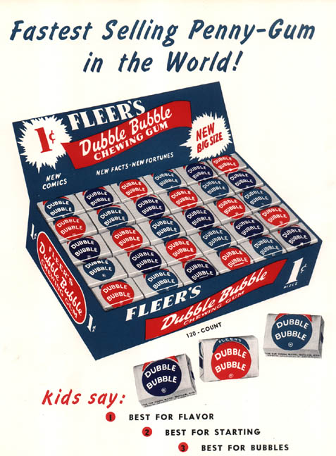

Slide 13
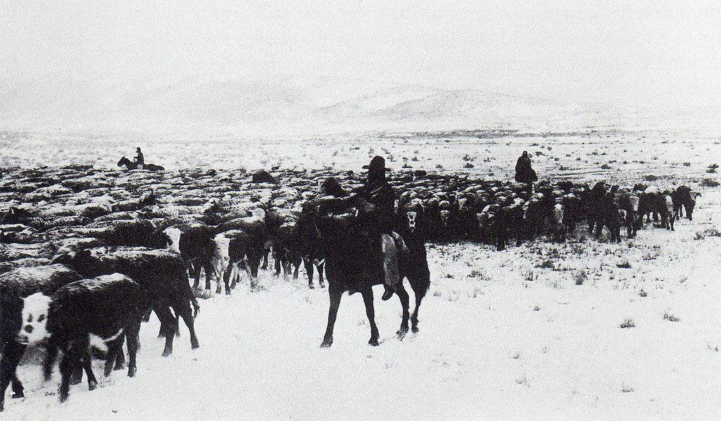

Slide 14
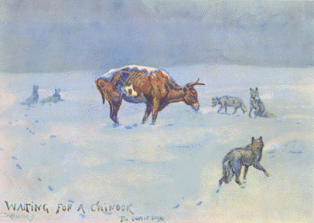
Waiting for a Chinook, by C.M. Russell. Overgrazing and harsh winters were factors
that brought an end to the age of the Open Range

Slide 15
Neocolonialism and Dependency
IB History
Modern Nations

Slide 16
Neocolonialism
Neocolonialism
the economic and political policies by which a great power indirectly maintains or extends its influence over other areas or people

Slide 17
The Great Export Boom
More than half a century of rapid, sustained economic growth
Total value of Mexican trade increased 900 percent between 1877–1910
By 1900, Brazil produced two-thirds of coffee drunk in the world
Cuba’s sugar production reached 5 million tons by 1929
Chilean nitrates, copper, iron worth hundreds of millions
Argentina’s wheat exports increased 1000 times by 1900
Smaller countries had their own version of export boom
Increase in railroads integral to the boom

Slide 18
Consequences in Latin America
Beneficiaries were large landowners and urban merchants.
Land values soared with railroads
Merchants and workers with secondary functions in import/export economy
Middle class grew rapidly
Argentina’s large middle class was one-third of population
Mexico’s small middle class was more typical

Slide 19
Consequences in Mexico
The majority of Latin Americans saw no benefit from progress
Railroads pushed peasants off their land in Mexico
Displaced peasants become employees of landowners
Indigenous people who had held on to communal land in Mexico were now forced out by landowners
Only 3 percent of Mexicans owned land in 1910
Most lived as peons on rural haciendas
Landless peasants had no place to grow subsistence crops
Once working for landowners, had little time to grow their own crops
Wages were often too small to support a family
Women and children joined labor force
Vagrancy laws harassed those who avoided wage labor

Slide 20
Consequences in Argentina
Argentina
Italian immigrants served as labor for wheat production
Rarely acquired their own land
Many moved into the cities
Gauchos vanished from the pampa
Wire fences
Fancy English breeds of cattle and sheep
Trade in chilled beef more profitable than dried beef
1876 first refrigerator ship
By 1900, refrigerator ships numbered in the hundreds

Slide 21
Other Consequences in Latin America
Coffee booms in the tropics
European immigrants needed in Brazil after abolition of slavery
To attract Europeans, landowners give some land for worker cultivation
Italian immigrants able to benefit from export boom
Usually they eventually moved to the cities
El Salvador, Guatemala and southern Mexico
Indigenous people provided the labor
Plantations owned by foreigners, usually Germans
Family farms grow some crops profitably
Coffee helps create a rural middle class in Colombia, Costa Rica, and Puerto Rico
Tobacco in Cuba and Brazil

Slide 22
Other Consequences in Latin America
Sugar and Mining
Massive, industrialized operations
Divided societies into rich and poor
Sugar dominated in northern Brazil, coastal Peru, and Caribbean
Owners of sugar refineries dominated rural economy
Immediate milling crucial to sugar production
Refinery owners set price; growers had little choice
Cane cutters
Industrialized workforce
Low wages
Spent half of the year unemployed
Cubans called it “the dead time”
Mining in Mexico, Peru, Bolivia, Chile
Powerful companies employ thousands of workers
Workers have little or no bargaining power
Usually foreign-owned, due to need for massive capital

Slide 23
Other Consequences in Latin America
Rubber boom in Amazonia
Latex sap of rubber tree used in United States for tires
Rubber harvesters lived isolated along Amazon river banks
In Brazil, many tappers fled droughts in the sertão
Elsewhere, many indigenous people became tappers
Low wages
Barely enough to pay for supplies they purchased from employers
Rubber trade produced huge profits for international traders
1910, rubber accounted for a quarter of Brazil’s export earnings
“Rubber barons” had more money than they could handle
Famously built an opera house deep in the Amazon
Rubber boom ravaged indigenous communities
Alcoholism
Disease
By the 1920s, Malaysian rubber undercut price, killing Amazon industry

Slide 24
Other Consequences in Latin America
Bananas
U.S. companies came to Caribbean basin in 1880s–90s
Merged into United Fruit Company (Railway)
Operated in Costa Rica, Honduras, Guatemala, Nicaragua, Panama, Colombia, Venezuela
Banana companies had far greater economic power than host countries

Slide 25
Other Consequences in Latin America
Bananas
“Banana Republics”
Foreign companies control governments
Companies control land
Companies control railroads, or sometimes vice-versa
Created company towns
Inhabited by managers, agronomists, engineers
Miniature U.S. cities
Company ships brought clothes, newspapers, etc. from United States.
Contributed little to the development of host nations
Managerial positions reserved for foreigners
Locals did “machete work”
Paid favorable taxes to government

Slide 26
Neocolonial Brazil
Oligarchic
Decentralized federation of twenty states
Landowners enjoyed local autonomy
Coffee and sugar planters, ranchers, rubber barons managed local elections to their benefit
Regional oligarchies controlled states
Each state kept its own export revenues
Two most powerful states – São Paulo and Minas Gerais

Slide 27
Neocolonial Brazil
Resistance in northeastern Brazil
1874–5, peasants rioted to reject imposition of metric weights that they believed would cheat them
Burned records and archives used to evict families who had no title to land
Bandits with Robin Hood reputations became folk heroes
Tradition of wandering holy men
Revived religious tradition
Sometimes believed to work miracles
(i) Antonio the counselor
(1) Preached against materialism and the “godless republic”
(2) Canudos, his base, becomes second largest city in the state
(3) Brazilian federal government attacks Canudos
(ii) The Backlands
(1) Famous chronicle of Canudos events
(2) Euclides de Cunha
(3) Describes clash as civilization vs. barbarism

Slide 28
Colonialism
Colonialism
Until late 1800s, Britain was most powerful in Latin America
Military exploits were limited
Argentina bore the brunt
Malvinas/Falklands
Commercial and financial expansion
Great Britain owned over half of Latin America’s foreign investment and debt
Great Britain was a model of progressive economics and politics
Men adopted British clothing
U.S. involvement began to displace British in 1890s
U.S. depression spurs desire for overseas markets
Alfred Thayer Mahan
Calls for stronger navy
Canal linking Atlantic and Pacific
Calls for annexation of Hawaii

Slide 29
Colonialism
U.S. attitudes toward Latin Americans shaped by racial prejudice
Rudyard Kipling’s “white man’s burden”
Duty of whites to civilize non-Europeans
Idea influenced U.S. mission in Latin America
Senator Alfred Beveridge – “God has marked the American people as His chosen nation to finally lead the regeneration of the world”
Roosevelt Corollary
Update to Monroe Doctrine
U.S. military would intervene around the region
U.S. newspapers caricature Latin American nations
Naughty schoolboys
“Little black Sambo”
Intervention needed to discipline Latin America

Slide 30
Colonialism
Pan-American Union
Promote free trade
Initially composed of ambassadors to the United States
Pan-American conferences
United States promoted trade
Latin American countries voiced dismay at U.S. interventions
Protests came to a head at Havana Conference of 1928

Slide 31
Colonialism
Latin American protest
United States had intervened in Cuba, Puerto Rico, Panama, as well as in Nicaragua, Haiti, and the Dominican Republic
By late 1920s, United States engaged in a war with Nicaraguan rebels
Led by Augusto Sandino
Accused United States of imperialism
Became hero to many Latin Americans
Latin American writers protest
Darío condemns “godless” Roosevelt
José Martí defends “our America”
(i) Cuba’s greatest patriotic hero
(ii) Exiled from Cuba at age 16
(iii) Edited magazine in Mexico
(iv) Taught in Guatemala
(v) Organized Cuban independence
(vi) Wrote on the United States from New York
José Enrique Rodó
(i) Uruguayan essayist
(ii) Wrote Ariel (1900)
(iii) Accused U.S. culture of crass materialism
Rise of cinema helped bind Latin America to United States

Slide 32
Colonialism
Neocolonial model shattered by depression
U.S. market crash in 1929
Demand for Latin American exports plummeted
Importation of progress halted

