Slide 1
Renaissance and Reformation
Chapter 13

Slide 2
Renaissance
Starts in Italy
Time of creativity and great change in many areas- political, social, economic, and cultural.
Shift from agricultural to urban society.
Shift from the church to more worldly aspects
Humanism
Francis Petrach (1304-1374) “Father of the Renaissance”
Education- Man is between beasts and angels
Studied classical Greece and Rome to understand own times.
Classical Latin was studied, not the crude Medieval Latin
Learning should be relevant and for many
Focused on worldly subjects rather than Church (though many were still strong Christians).
Humanities (Grammar, rhetoric, poetry, and history)

Slide 3
Renaissance Art
Leonardo da Vinci (1452-1519)
Mona Lisa and The Last Supper
Michelangelo (1475-1564)
David
Sistine Chapel in Rome

Slide 4
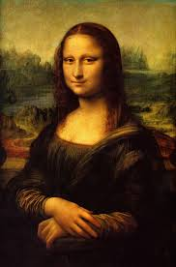

Slide 5
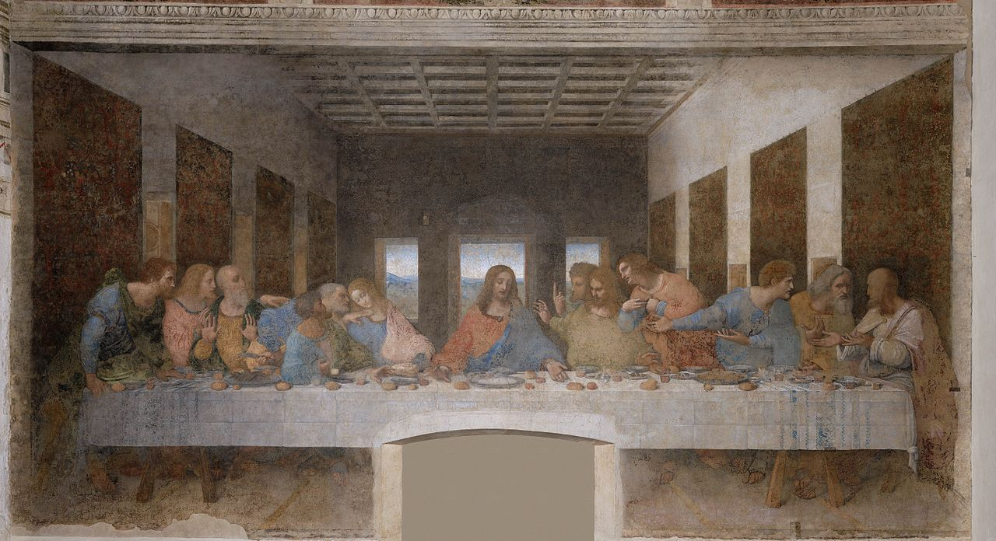

Slide 6
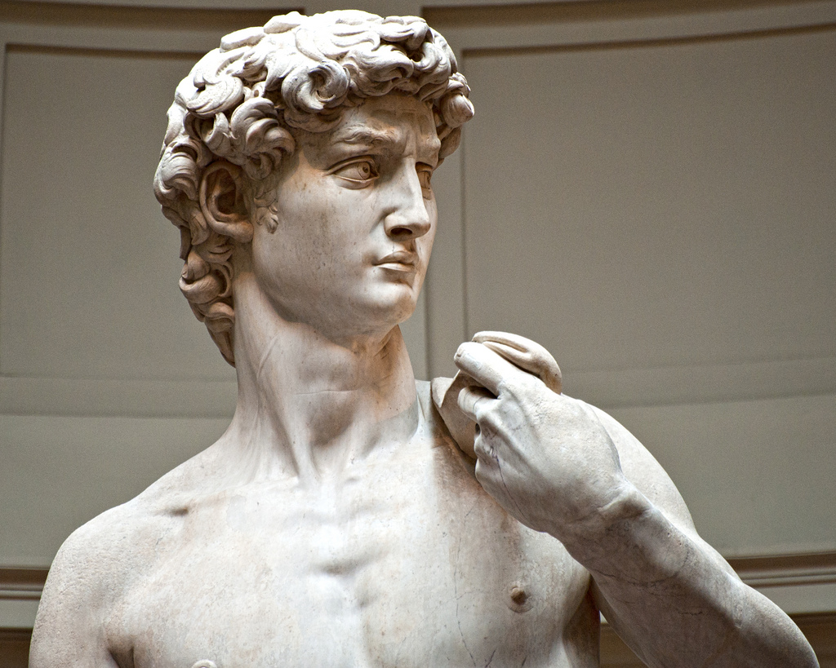

Slide 7
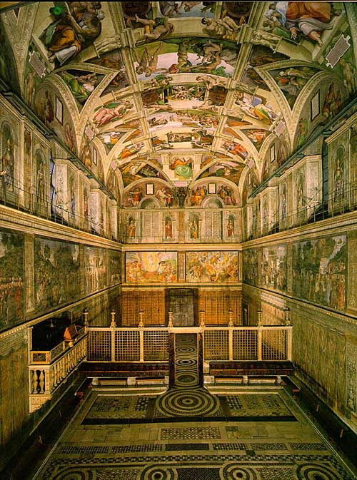

Slide 8
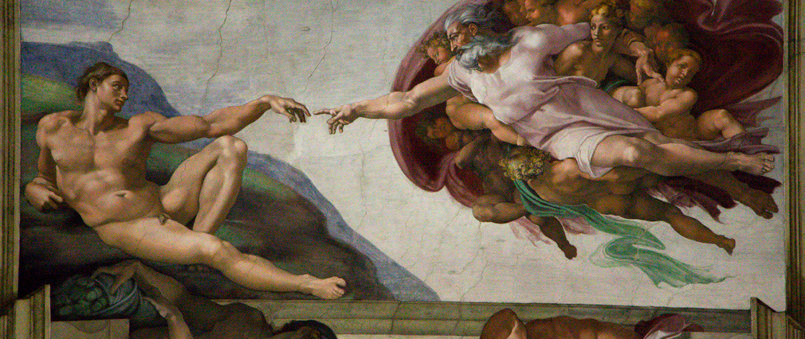

Slide 9
Renaissance
Machiavelli (1469-1527)
Wrote The Prince which was a guide for how rulers should gain and maintain power.
The end justifies the means.
Sir Thomas More
Called for social reform.
Believed in a utopian society.
William Shakespeare
Between 1590 to 1613 he wrote 37 plays.
More than 1,700 words appeared for the first time in his works.

Slide 10
Protestant Reformation
1500s
Church Abuses
Popes competing for power with princes
Fought wars to protect Papal lands
Fought to expand its own interests
Indulgences

Slide 11
Martin Luther
German monk and professor of theology at the University of Wittenberg in Saxony
Became monk because of a thunderstorm.
Frederick III (the wise) ruler of Saxony in HRE
Reason for Luther’s survival and success
This only happens because of the exact right timing
October 31, 1517 he writes his 95 Theses, or arguments against indulgences and other beliefs of the church.
Saved by faith
Pope had no authority to release souls from purgatory.
Posts on the door of Wittenberg’s All Saints Church

Slide 12
Charles V
Charles V becomes HR Emperor (Martin Luther’s beliefs are becoming a problem)
Pope Leo X excommunicates Luther after giving him a chance to repent.
Diet (a council) of Worms, 1521
Martin Luther invited (given a safe conduct pass)
Thought he would get to defend his beliefs
Instead, it is more of a plan to stop him.
Edict of Worms
Declares Martin Luther a heretic (others had been burned)
Able to escape b/c it has to be written up by a committee.
Escapes back to Saxony where he is protected by Frederick III
Princes like Luther because they are sick of the church being run like a monarch or business.

Slide 13
Catholics vs. Protestants
Catholic Views
Protestant Views
Free Will- behavior determines afterlife
Salvation needs faith and works
Religious Authority- Bible, church councils, pope, & church fathers.
7 sacraments- baptism, penance, Eucharist, confirmation, matrimony, holy orders, extreme unction (last rights.
Some pre-destined for salvation (most free will)
Salvation comes through Faith alone
Religious Authority- Bible alone
2 sacraments- baptism and Eucharist (communion)

Slide 14
Lutheranism Spreads
Successful because of the right time & place.
3 major reasons:
Religious
Catholic church had become an institution
Didn’t meet spiritual needs
Political
Luther supported secular authority over religious leaders
“Give to Caesar what is Caesar’s.”
Economic
Catholic church owned a lot of land (through wills)
Territory becomes Lutheran, people no longer leave land to church
German Princes confiscate Catholic land
Breaks up into different denominations
Calvinists (France=Huguenots; England= Puritans)

Slide 15
English Reformation
Henry VIII
Stood against Protestant Reformation
Married to Spanish wife, Catherine of Aragon
In 18 years, only one surviving child, Mary Tudor.
Wanted a male heir
Requests an Annulment from the Pope who refuses.
Henry breaks away from the Catholic Church and creates the Church of England in which he is the Head of it.
Saint Thomas More
Refuses to acknowledge and is killed

Slide 16
Henry VIII Family
Children
Mary I (Bloody Matry), Elizabeth I
Edward VI (from third wife), didn’t live long and was succeeded by Mary and Elizabeth.
Only son to survive infancy
King at 9 and dies at 15.
Wives
Catherine- Divorced
Anne Boleyn- Beheaded (Adultery, incest, and treason)
Jane Seymour (mistress before wife)- Died shortly after giving birth to Edward VI
Anne of Cleves- Ugly so divorced (Marriage treaty)
Catherine Howard- Beheaded for treason (adultery)
Catherine Parr- Outlived him

