Slide 1
Ch. 2.5 Ancient Hebrews and the birth of Judaism

Slide 2
Religion
Monotheistic
Unlike other religions, believed everyone was equal before God.
Torah
First five books of the Hebrew Bible
Genesis, Exodus, Leviticus, Numbers, and Deuteronomy.
Talmud
Came much later and included additional customs and traditions.

Slide 3
Lineage
Abraham made a covenant
Father of the Israelites
Patriarch of the Hebrew Nation

Slide 4
Lineage
Patriarchal Society:
father is the head of family life
Males are dominate in society

Slide 5
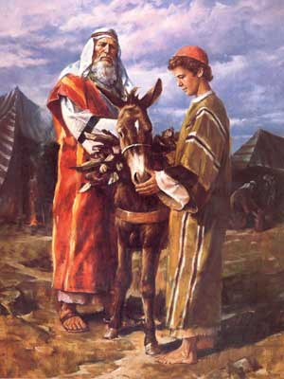
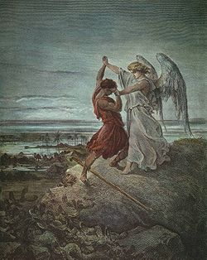
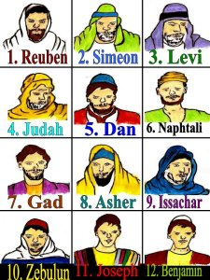
Abraham
Isaac
Jacob
Twelve Tribes of Israel

Slide 6
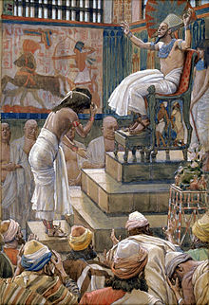
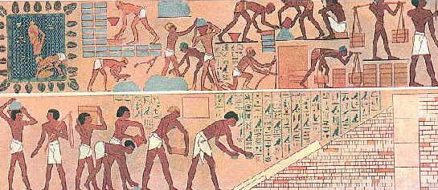
Path To Egypt
Famine
Slavery

Slide 7
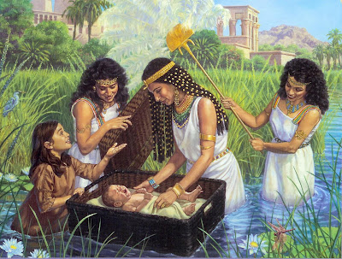
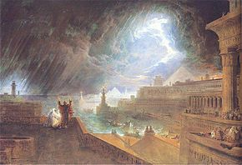
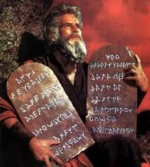
Moses and the Exodus
Slavery
Moses set sail down the river
Adopted by Pharaoh
Raised as Egyptian Prince
Exiled
Chosen by God
10 Plagues
Led Israelite nation from Egypt
10 Commandments
Promised Land
Notes:
Pharo

Slide 8
Hebrew Kings
Saul
David
Solomon

Slide 9
Conquered
Babylon (Chaldeans)
Persia
Rome

Slide 10
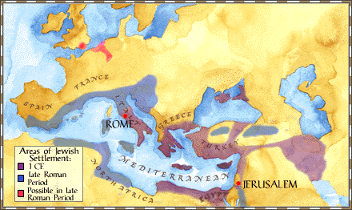
Diaspora
Jews living outside of Israel

Slide 11
Influences
Christianity
Islam
Judeo - Christian

Slide 12
http://en.wikipedia.org/wiki/File:Sarah_Abraham.jpg
http://en.wikipedia.org/wiki/Jacob
https://www.google.com/search?as_q=abraham&orq=&tbs=sur:fm&biw=1366&bih=643&sei=n2s_UJTPOZTFqQGit4GADw&tbm=isch#hl=en&tbs=sur:fm&tbm=isch&sa=1&q=10+commandments&oq=10+commandments&gs_l=img.3..0l10.2258.4412.0.4763.15.6.0.9.9.0.124.590.4j2.6.0...0.0...1c.vuK9fa5InWA&pbx=1&bav=on.2,or.r_gc.r_pw.r_cp.r_qf.&fp=c07bdc714a5b29fd&biw=1366&bih=643
http://en.wikipedia.org/wiki/Plagues_of_Egypt
http://moseseditor.blogspot.com/2012/08/moses-actually-has-historical.html
http://www.pbs.org/wgbh/pages/frontline/shows/religion/maps/jewish.html
http://en.wikipedia.org/wiki/Joseph_(son_of_Jacob)
http://www.britam.org/HebrewTypes.html

