Slide 1
Self Rule for Canada
Chapter 25.3

Slide 2
Constitutional Act of 1791
Established to help the 10,000 English speaking people adjust in Canada after the American Revolution.
Reformed the government of Canada
Split it into two
Upper Canada
Family Compact- group that held most of the power
Lower Canada
Chateau Clique

Slide 3
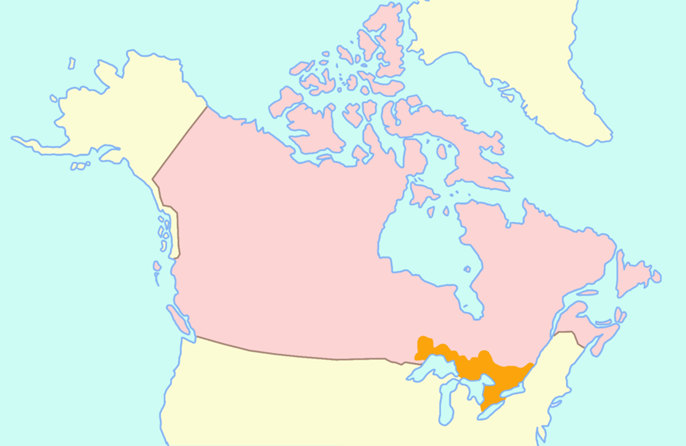
Upper Canada

Slide 4
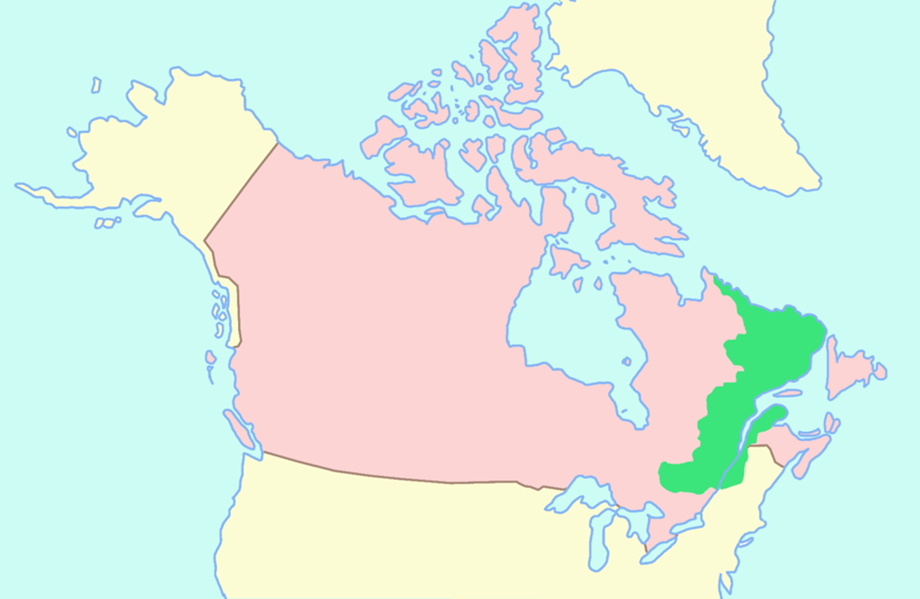
Lower Canada

Slide 5
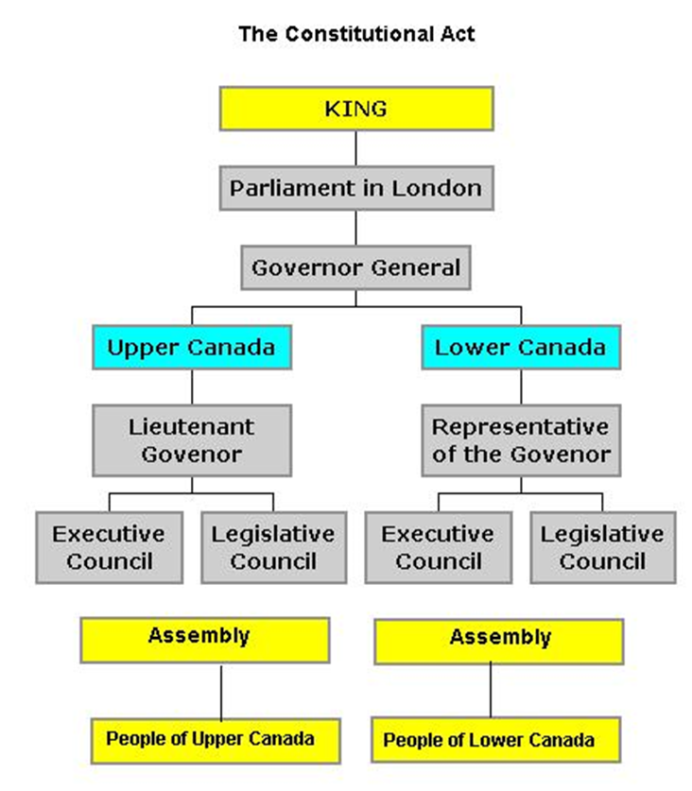

Slide 6
Background
Following a theme of revolutions
American Revolution of 1776
French Revolution of 1789-1799
Haitian Revolution 1791-1794
Irish Rebellion of 1798
Sought republicanism

Slide 7
Two Poles by 1834
Two poles emerge in Lower Canada
Supporters of the “Chateau Clique”
Reformers the Parti Patriote led by Louis-Joseph Papineau & William Lyon MacKenzie’s Reform Party

Slide 8
1837 rebellions
Problems
People wanted responsible government
Economic hardships in Canada
Immigration led to poverty and epidemics
Inequality of land
Social inequality (hierarchy)
Leads to 1837 rebellions

Slide 9
Durham Report
Lord Durham sent to investigate the rebellions
Writes the Durham Report (1839)
Recommends uniting Canada
Later becomes governor of both Canadas.
Tories make reforms
Special Council created in Lower Canada
Until Union Act of 1840
Union Act of 1840
United Upper and Lower Canadas
Notes:
The Special Council of Lower Canada was an appointed body which administered Lower Canada until the Union Act of 1840 created the Province of Canada. Following the Lower Canada Rebellion, on March 27, 1838, the Constitutional Act of 1791 was suspended and both the Legislative Assembly and Legislative Council were dissolved.

Slide 10
British North America Act of 1867
Also called Constitution Act, 1867
Act of Parliament of the United Kingdom
Three British colonies in North America—Nova Scotia, New Brunswick, and Canada—were united as “one Dominion under the name of Canada”
Other colonies and territories of British North America could be admitted.
Divided the province of Canada into the provinces of Quebec and Ontario and provided them with constitutions.
Autonomy extended only to internal affairs. External affairs, such as border negotiations with the United States, were still controlled from Britain

Slide 11
Gradual Autonomy
Gradual autonomy from Great Britain
1867- British North America Act
1931- Statute of Westminster
1982- Canada Act of 1982

