Slide 1
Social & Cultural Changes
Modern Nations

Slide 2
THE TWENTIES WOMAN
After the tumult of World War I, Americans were looking for a little fun in the 1920s
Women were becoming more independent and achieving greater freedoms (19th Amendment on May 19th, 1919- right to vote; more employment; freedom of the auto- weren’t stuck on the farm anymore)
Chicago 1926

Slide 3
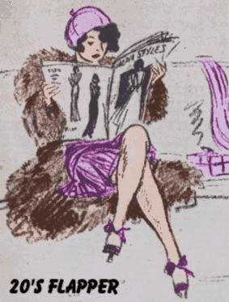
THE FLAPPER
During the 1920s, a new ideal emerged for some women: the Flapper
A Flapper was an emancipated young woman who embraced the new fashions and urban attitudes

Slide 4
NEW ROLES FOR WOMEN
Early 20th Century teachers
The fast-changing world of the 1920s produced new roles for women
Many women entered the workplace as nurses, teachers, librarians, & secretaries
However, women earned less than men and were kept out of many traditional male jobs (management) and faced discrimination

Slide 5
THE CHANGING FAMILY
American birthrates declined for several decades before the 1920s
During the 1920s that trend increased as birth control information became widely available
Birth control clinics opened and the American Birth Control League was founded in 1921
Margaret Sanger and other founders of the American Birth Control League - 1921

Slide 6
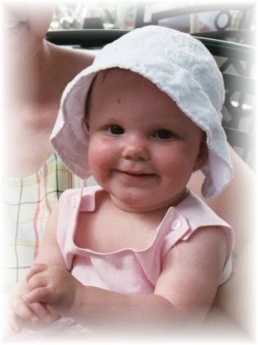
MODERN FAMILY EMERGES
As the 1920s unfolded, many features of the modern family emerged
Marriage was based on romantic love, women managed the household and finances, and children were not considered laborers/ wage earners but rather developing children who needed nurturing and education

Slide 7
Feminism in Latin America
Rise of feminist movements
Feminist movements emerge in places where international influence was greatest
Patriarchy goes largely unchallenged in rural areas
Many feminist leaders had non-Iberian surnames
Paulina Luisi of Uruguay
First woman in Uruguay to get a medical degree
Italian name typical of immigrant-populated Montevideo
Called an anarchist for urging use of a sex education textbook
Represented Uruguay at international women’s conferences
In 1919 began drive for women’s voting rights in Uruguay
1922 honorary vice president of Pan-American Conference on Women

Slide 8
EDUCATION AND POPULAR CULTURE
During the 1920s, developments in education had a powerful impact on the nation
Enrollment in high schools quadrupled between 1914 and 1926
Public schools met the challenge of educating millions of immigrants

Slide 9
WE INTERRUPT THIS POWERPOINT FOR A LOOK AT SOME OF BART SIMPSON’S FUNNIEST SENTENCES HE WROTE ON THE SCHOOL BLACKBOARD

Slide 10
I am not authorized to fire substitute teachers.
I will not spank others.
I will not aim for the head.
I will not barf unless I'm sick.
I will not expose the ignorance of the faculty.
I saw nothing unusual in the teacher's lounge.
I will not conduct my own fire drills.
Funny noises are not funny.
I will not snap bras.
I will not fake seizures.
This punishment is not boring and pointless.
My name is not Dr. Death.
I will not defame New Orleans.
I will not prescribe medication.
I will not bury the new kid.
I will not teach others to fly.
I will not bring sheep to class.
A burp is not an answer.
Teacher is not a leper.
Coffee is not for kids.
I will not eat things for money.
I will not yell "She's Dead" at roll call.
The principal's toupee is not a Frisbee.
I will not call the principal "spud head."
Goldfish don't bounce.
Mud is not one of the 4 food groups.
No one is interested in my underpants.
I will not sell miracle cures.
I will return the seeing-eye dog.
I do not have diplomatic immunity.

Slide 11
Organ transplants are best left to professionals.
The Pledge of Allegiance does not end with "Hail Satan."
I will not celebrate meaningless milestones.
There are plenty of businesses like show business.
Five days is not too long to wait for a gun.
I will not waste chalk.
I will not skateboard in the halls.
I will not instigate revolution.
I will not draw naked ladies in class.
I did not see Elvis.
I will not call my teacher "Hot Cakes."
Garlic gum is not funny.
They are laughing at me, not with me.
I will not yell "Fire" in a crowded classroom.
I will not fake my way through life.
Tar is not a plaything.
I will not Xerox my butt.
It's potato, not potatoe.
I will not trade pants with others.
I am not a 32 year old woman.
I will not do that thing with my tongue.
I will not drive the principal's car.
I will not pledge allegiance to Bart.
I will not sell school property.
I will not burp in class.
I will not cut corners.
I will not get very far with this attitude.
I will not belch the National Anthem.
I will not sell land in Florida.
I will not grease the monkey bars.
I will not hide behind the Fifth Amendment.

Slide 12
I will not do anything bad ever again.
I will not show off.
I will not sleep through my education.
I am not a dentist.
Spitwads are not free speech.
Nobody likes sunburn slappers.
High explosives and school don't mix.
I will not bribe Principal Skinner.
I will not squeak chalk.
I will finish what I started.
I will not use abbrev.
"Bart Bucks" are not legal tender.
Underwear should be worn on the inside.
The Christmas Pageant does not stink.
I will not torment the emotionally frail.
I will not whittle hall passes out of soap.
Wedgies are unhealthy for children and other living things.
I do not have power of attorney over first graders.
I am not the reincarnation of Sammy Davis Jr.
I am not certified to remove asbestos.
"Bagman" is not a legitimate career choice.
I will not retransmit without the express permission of Major League Baseball.
I will remember to take my medication.
The boys room is not a water park.
Beans are neither fruit nor musical.
Nerve gas is not a toy.
"Bewitched" does not promote Satanism.
The First Amendment does not cover burping.
Ralph won't "morph" if you squeeze him hard enough.
Cursive writing does not mean what I think it does.
No one wants to hear my armpits.

Slide 13
EXPANDING NEWS COVERAGE
As literacy increased, newspaper circulation rose and mass-circulation magazines flourished
By the end of the 1920s, ten American magazines -- including Reader’s Digest and Time – boasted circulations of over 2 million

Slide 14
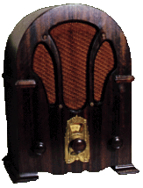
RADIO COMES OF AGE
Although print media was popular, radio was the most powerful communications medium to emerge in the 1920s
News was delivered faster and to a larger audience
Americans could hear the voice of the president or listen to the World Series live

Slide 15
AMERICAN HEROES OF THE 20s
In 1929, Americans spent $4.5 billion on entertainment (includes sports)
People crowded into baseball games to see their heroes
Babe Ruth was a larger than life American hero who played for Yankees
He hit 60 homers in 1927

Slide 16
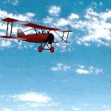
LINDBERGH’S FLIGHT
America’s most beloved hero of the time wasn’t an athlete but a small-town pilot named Charles Lindbergh
Lindbergh made the first nonstop solo trans-atlantic flight
He took off from NYC in the Spirit of St. Louis and arrived in Paris 33 hours later to a hero’s welcome

Slide 17
ENTERTAINMENT AND ARTS
Even before sound, movies offered a means of escape through romance and comedy
First sound movies: Jazz Singer (1927)
First animated with sound: Steamboat Willie (1928)
By 1930 millions of Americans went to the movies each week
Walt Disney's animated Steamboat Willie marked the debut of Mickey Mouse. It was a seven minute long black and white cartoon.

Slide 18
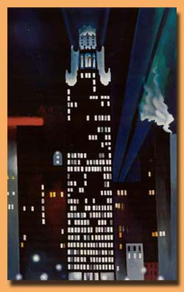
MUSIC AND ART
Famed composer George Gershwin merged traditional elements with American Jazz
Painters like Edward Hopper depicted the loneliness of American life
Georgia O’ Keeffe captured the grandeur of New York using intensely colored canvases
Radiator Building, Night, New York , 1927 Georgia O'Keeffe
Gershwin
Hopper’s famous “Nighthawks”

Slide 19
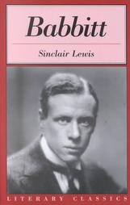
WRITERS OF THE 1920S
The 1920s was one of the greatest literary eras in American history
Sinclair Lewis, the first American to win the Nobel Prize in literature, wrote the novel, Babbitt
In Babbitt the main character ridicules American conformity and materialism

Slide 20
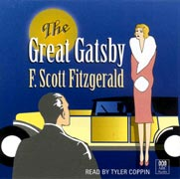
WRITERS OF THE 1920s
Writer F. Scott Fitzgerald coined the phrase “Jazz Age” to describe the 1920s
Fitzgerald wrote This Side of Paradise and The Great Gatsby
The Great Gatsby reflected the emptiness of New York elite society

Slide 21
WRITERS OF THE 1920S
Edith Warton’s Age of Innocence dramatized the clash between traditional and modern values
Willa Cather celebrated the simple, dignified lives of immigrant farmers in Nebraska in My Antonia

Slide 22
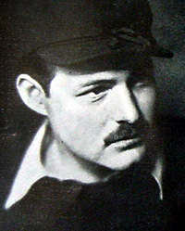
WRITERS OF THE 1920
Ernest Hemingway, wounded in World War I, became one of the best-known authors of the era
In his novels, The Sun Also Rises and A Farewell to Arms, he criticized the glorification of war
His simple, straightforward style of writing set the literary standard
Hemingway - 1929

Slide 23
THE LOST GENERATION
Some writers such as Hemingway and John Dos Passos were so soured by American culture that they chose to settle in Europe
In Paris they formed a group that one writer called, “The Lost Generation”
John Dos Passos self – portrait. He was a good amateur painter.

Slide 24
THE HARLEM RENAISSANCE
Between 1910 and 1920, the Great Migration saw hundreds of thousands of African Americans move north to big cities
By 1920 over 5 million of the nation’s 12 million blacks (over 40%) lived in cities
Migration of the Negro by Jacob Lawrence

Slide 25
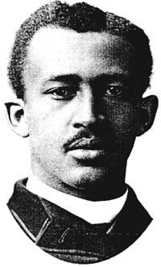
AFRICAN AMERICAN GOALS
Founded in 1909, the NAACP urged African Americans to protest racial violence
W.E.B Dubois, a founding member, led a march of 10,000 black men in NY to protest violence

Slide 26
MARCUS GARVEY - UNIA
Marcus Garvey believed that African Americans should build a separate society (Africa)
In 1914, Garvey founded the Universal Negro Improvement Association
Garvey claimed a million members by the mid-1920s
He left a powerful legacy of black pride, economic independence and Pan-Africanism
Garvey represented a more radical approach

Slide 27
HARLEM, NEW YORK
Harlem, NY became the largest black urban community
Harlem suffered from overcrowding, unemployment and poverty
However, in the 1920s it was home to a literary and artistic revival known as the Harlem Renaissance

Slide 28
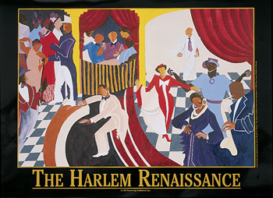

Slide 29
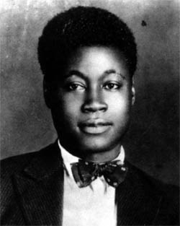
AFRICAN AMERICAN WRITERS
Mckay
The Harlem Renaissance was primarily a literary movement
Led by well-educated blacks with a new sense of pride in the African-American experience
Claude McKay’s poems expressed the pain of life in the ghetto

Slide 30
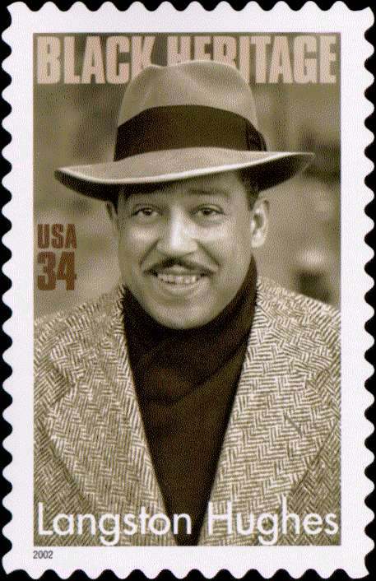
LANGSTON HUGHES
Missiouri-born Langston Hughes was the movement’s best known poet
Many of his poems described the difficult lives of working-class blacks
Some of his poems were put to music, especially jazz and blues

Slide 31
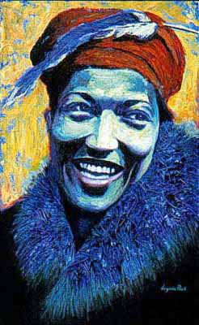
ZOLA NEALE HURSTON
Zola Neale Hurston wrote novels, short stories and poems
She often wrote about the lives of poor, unschooled Southern blacks
She focused on the culture of the people– their folkways and values

Slide 32
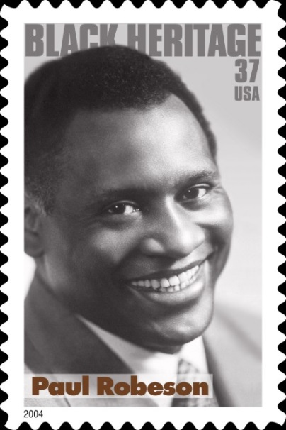
AFRICAN-AMERICAN PERFORMERS
During the 1920s, black performers won large followings
Paul Robeson, son of a slave, became a major dramatic actor
His performance in Othello was widely praised

Slide 33
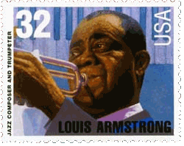
LOUIS ARMSTRONG
Jazz was born in the early 20th century
In 1922, a young trumpet player named Louis Armstrong joined the Creole Jazz Band
Later he joined Fletcher Henderson’s band in NYC
Armstrong is considered the most important and influential musician in the history of jazz

Slide 34
EDWARD KENNEDY “DUKE” ELLINGTON
In the late 1920s, Duke Ellington, a jazz pianist and composer, led his ten-piece orchestra at the famous Cotton Club
Ellington won renown as one of America’s greatest composers

Slide 35
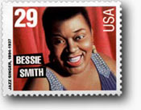
BESSIE SMITH
Bessie Smith, blues singer, was perhaps the most outstanding vocalist of the decade
She achieved enormous popularity and by 1927 she became the highest- paid black artist in the world

Slide 36
Feminism in Latin America
Berta Lutz
Father was Swiss-Brazilian, mother English
Became a biologist
Left São Paulo to study in Europe
In 1918, published a feminist call-to-arms
Said Brazilian women were lagging behind European and U.S. women
Women could be “valuable instrument of progress in Brazil”
Brazilian Federation for Feminine Progress
Brazilian women got vote in 1932, before Uruguayan, Argentine, or most Latin American women

Slide 37
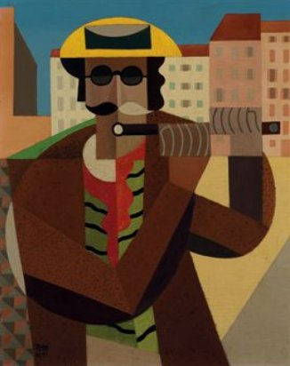
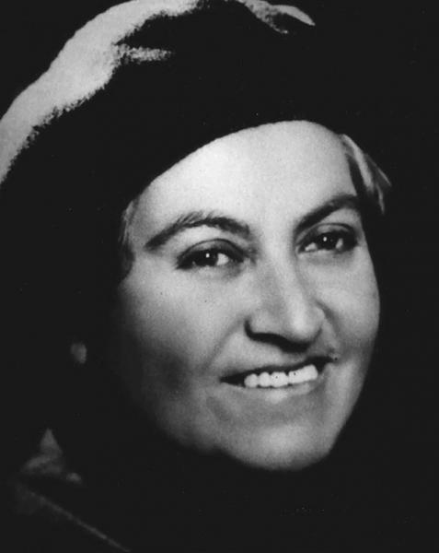
Arts
Emilio Pettoruti- Argentine
caused a scandal with his avant-garde cubist exhibition in 1924
1920s Mexican artist Renaissance
Gabriela Mistral
Chile; moved to Mexico in 1923
Poet and educator
Tina Modotti- Italian photographer
Latin America artists start playing into the international scene largely controlled by Europe.
Mexico City becomes one of the largest cities with radical ideologies contributed to art.
Becomes a hub for radicals, exiles, and revolutionaries.

Slide 38
Education Latin America
Education became important to landowning families.
Most studied law
Intended for politics
Urbanization meant education
Argentina and Uruguay were most literate
Brazil, mostly rural, only 2 in 10 literate

Slide 39
Education Latin America
Education opened doors to mixed-race people
Joaquim Maria Machado de Assis
Considered greatest Brazilian novelist
Mother was a laundress
Worked his way up
Became president of Academy of Letters
Rubén Dário
Mestizo from Nicaragua
Received universal reverence
One of the most influential Spanish-language poets

