Slide 1
The Origins of the Cold War
Chapter 15.1

Slide 2
Yalta Conference
Meeting between Roosevelt, Churchill, and Stalin
To discuss a plan for the postwar world
Poland
Soviet troops occupied Poland
Encouraged communists to set up a new government
Churchill and Roosevelt want Poland to choose
Stalin wants it to be communist so it will be friendly to the USSR
Compromise
Roosevelt and Churchill agree to recognize the gov set up by the Soviets
Stalin agrees to hold free elections ASAP.

Slide 3
The Declaration of Liberated Europe
Agreed upon by Churchill, Roosevelt, and Stalin.
"the right of all people to choose the form of government under which they will live.“
Promoted democracy and free elections

Slide 4
Dividing Germany
Stalin wants Germany to pay heavy reparations
Roosevelt agreed, but he insisted reparations be based on Germany's ability to pay.
He also suggested Germany be able to pay with trade goods instead of simply cash.
Stalin also wants a weak Germany to ensure countries that are under Soviet control, stay under Soviet control.

Slide 5
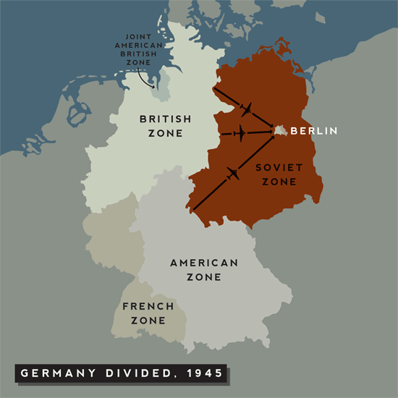
Dividing Germany

Slide 6
Cold War
This all starts a Cold War
Era of confrontation and competition between two nations which become increasingly hostile but refrain from physical war.

Slide 7
Soviet and American Differences
Soviet leaders were communists and believed communism was the superior economic system.
Believed it would replace capitalism
Lenin theorized capitalist countries would try to destroy communism.
Americans believed the Depression was the reason for Hitler to come to power.
Roosevelt believed the key to peace was to promote economic growth.

Slide 8
Potsdam Conference
Truman takes office
Believed industry critical to recovery in Germany and thus Europe.
Stalin still wanted reparations
Truman suggests Stalin take reparations from his zone while the rest of Germany is allowed to revive.
Agree upon this with the idea a small amount of German industrial equipment from other zones and accepted new German-Polish border.

Slide 9
Satellite Nations and Iron Curtain
Communist countries of Eastern Europe came to be called satellite nations.
nations politically and economically dominated or controlled by another more powerful country.
Winston Churchill referred to an "iron curtain" falling across Eastern Europe.
the political and military barrier that isolated Soviet-controlled countries of Eastern Europe after World War II.

