Slide 1
Treaty of Versailles

Slide 2
Who was invited?
Britain, United States, France and Italy
Who is missing?
Germany not invited
Russia not invited
Allied powers were upset because Russia pulled out of the war which eliminated the two front war for Germany.
Not happy about this.
Lost the most people
Lost land to Germany with its treaty

Slide 3
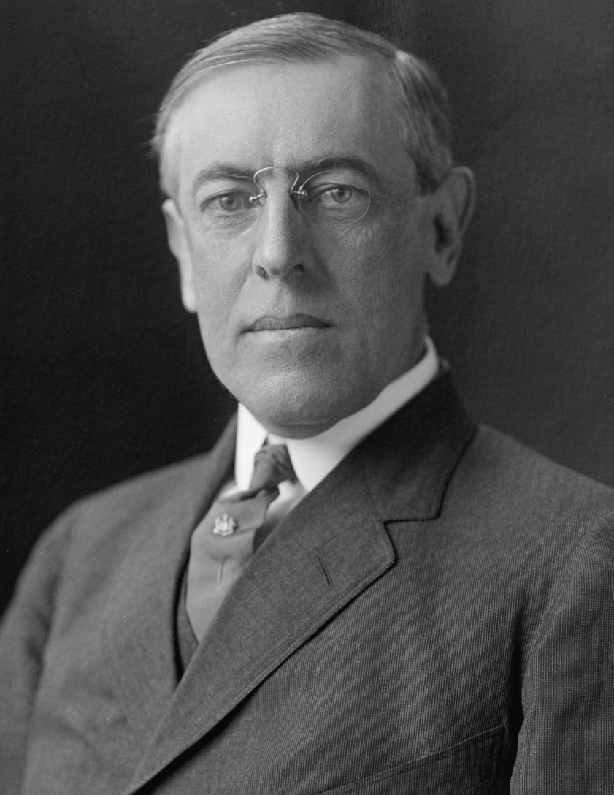
Woodrow Wilson’s Vision
14 Points
Concerned with:
rebuilding the European economy
encouraging self-determination
promoting free trade
creating appropriate mandates for former colonies
creating a powerful League of Nations
Opposed harsh treatment of Germany

Slide 4
Britain and France’s vision
France
Devastated by Germany
Much of the war had been fought on French soil
Argued US and Britain were both sheltered and protected by oceans (even Napoleon couldn’t touch England).
Wanted to keep Germany weak
Wanted reparations (What are reparations?)
Britain
Experienced far less casualties and devastation
Supported reparations to lesser extent
Concerned though it might harm Germany from being an important trading partner.

Slide 5
Components of the Treaty
War Guilt Clause
Territory changes
Germany had to give up lands it obtained from the Russian Treaty and recognize independence of Czechoslovakia
Military restrictions
Maximum of 100,000 troops and demilitarization of the Rhineland by Germany. No manufacturing of tanks, chemical weapons, or aircraft.
Reparations ($5 billion)
League of Nations established

Slide 6
Ramifications of the treaty
Harmed Germany’s economy
Germany went into a depression shortly after the treaty.
Paid off war debt in 2010.
Bittered many Germans
Hitler and the Nazi party used the treaty to rally support of Germans (war guilt clause).
Hitler and Nazi party rise to power and violate treaty
Introduce mandatory military service
Reoccupy Rhineland
Annex Austria in Anschluss

Slide 7
US Response to the treaty
Representatives of each country signed the treaty in June 1919.
However, US senate still needed to approve it.
Senate majority leader was afraid US was giving up too much power with the League of Nations.
Senate voted on it twice: (1) with reservations (2) without reservations – Neither passed.
US signs Knox-Porter Resolution to end war with Germany formally.
US never joined the League.

