Slide 1
Youth Protests and Counterculture Movement, 1960s & 1970s
Civil Rights

Slide 2
Reasons
Renewed interest in the politics of the left
Baby boomers becoming young adults (increase in the number of college students)
Began questioning the materialistic, consumerist and conformist US culture
The need to promote values of sharing and community, liberty, racial, economic and social justice.
Urge to reassert rights and to have a say in how universities were run.
The influence of the media inspiring and spreading the protests.

Slide 3
Reasons
Inspiration of the Civil Rights Movement
Perceived immorality of the Vietnam War

Slide 4
Impact
Growing polarization and fragmentation of society
Youth involvement in civil rights’ protests such as the Freedom Rides and the Greensboro sit-ins
Radicalization and militancy of American college and university students that led to the split and loss of support for the SDS
Mounting tension due to brutal police repression

Slide 5
Impact
Enactment of very few reforms
Fear among Middle America the “silent majority”
Resulted in a return to conservative politics in the early 1970s
Protests helped to push the issue of war into the center of American politics (Nixon’s Vietnamization)
“Rights Revolution”
Inspired protests of other groups (women, gays and lesbians, Native Americans).

Slide 6
Aims of the Counterculture Movement
Big theme:
Personal Freedoms

Slide 7
Protests
Students Democratic Society (SDS)
Port Huron Statement
New Left
Protest about university and other broader issues- combined with anti-war movements.
1964 in Berkeley – University of California
Free Speech Movement
Columbia University, 1968
Harvard
1969 Berkeley (over the People’s Park)
Anti-war protest in 1970 at Kent State University in Ohio.

Slide 8
Hippies!
During the 1960s and 1970s.
Member of a countercultural movement that rejected the mores of mainstream American life.
The movement originated on college campuses in the United States, although it spread to other countries, including Canada and Britain.

Slide 9
Woodstock
Music festival in Woodstock, NY.
Featured: Jimmy Hendrix, Blood, Sweat & Tears; Santana; Crosby, Stills, Nash & Neil Young and many more.
Rolling Stone listed it as one of the 50 Moments That Changed the History of Rock and Roll.

Slide 10
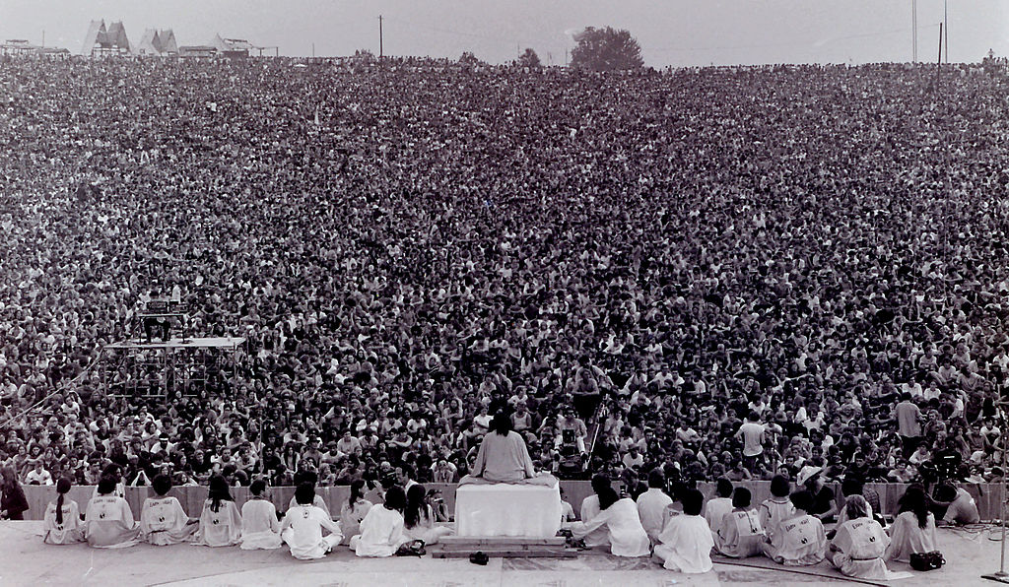

Slide 11
Latin America
Brazil
University students protested against the repressive military dictatorship of Artur da Costa e Silva.
Demanded the return to democracy
Opposed the government’s educational policies and US interference in Brazilian education.
Examples:
Series of anti-government demonstrations in reaction to the murder of the student Edson Luis Lima Souto by the polic in early 1968.
Hundred Thousand March in Rio on June 26, 1968.
Impact
Massive arrests and brutal police repression
Army occupation of the Law School in Sao Paulo and the University of Brasilia, among others.
Tightening of military control through the AI-5 (Institutional Act #5)
Stricter censorship of the media

Slide 12
Latin America
Mexico
1968, students demanded greater political freedom and the end to the one-party oligarchic rule of the PRI (Institutional Revolutionary Party).
Over 50,000 students led by the national Autonomous University of Mexico (UNAM) protested against the brutal repression of students and teachers.
Resulted in the army occupation of the UNAM and in violent confrontations between soldiers and students.
Peaceful demonstration organized by the CNH (National Strike Council) in the Plaza de las Tres Culturas resulted in the Tlatelolco Massacre (October 1968).

